Slide 1


Welcome
License Exempt Provider Preservice Training
Notes:
Talking Points/Facilitation Notes
Welcome participants to the training by introducing yourself and any other trainers or staff who will be supporting the group

Slide 2


Please complete the pre-survey below if you have not already!
https://forms.office.com/r/0srhKhNjDw
Notes:
Talking Points/Facilitation Notes
Guide participants to complete the pre-survey and provide support as needed
https://forms.office.com/r/0srhKhNjDw
*make sure participants type this link directly into their browser; if they do a search it will bring up the entire LEPPT PowerPoint pdf*
If training virtually, type the link into the chat box
In person, you can have participants show you their screens with the survey completion message or have them do a paper copy (these will need to be entered in manually by the trainer after the LEPPT)

Slide 3

License Exempt Provider Preservice Training:
Level 1 of Michigan’s Quality Development Continuum
Notes:
Talking Points/Facilitation Notes
Introduce the training and its purpose –
an orientation designed to prepare License Exempt Providers to provide care using best practices that support the health and safety of children
Discuss how research has led to changes in what’s safest for children over the years – new knowledge leads to changes in best practice
Share that the LEPs receive training on these federally mandated health and safety topics because they are essential to supporting an environment where children can grow and thrive
Tell providers that completing this training meets the federal requirement to become a Level 1 License Exempt Provider and that it only needs to be taken once, with an online Health and Safety Refresher course every year after
Talk to providers about the importance of their role as care providers and encourage them to share what they learn in the training with families

Slide 4

Agenda
9:00 am – 1:30 pm
  Welcome and Introductions
  Health and Safety Topics
  First Aid and CPR Overview
Notes:
Talking Points/Facilitation Notes
Review the agenda

Slide 5





Housekeeping
Muting/Unmuting
Using the Chat
Using Polls
Asking Questions
Resource Packet
Notes:
Talking Points/Facilitation Notes
Explain the purpose of keeping webcams on
Help those who want to turn their camera on
Explain how to tell if mic is muted or unmuted
Explain how to unmute and mute mic
Explain how to find the chat box on different devices
Explain how to use the chat to share ideas
Explain how to ask questions privately
Explain the Resource Packet
It’s on the great start to quality website
A link will be emailed
At the end of the training request a resource packet, if they have not done so when registering for the course in MiRegistry
Explain that a local resource center staff will reach out by phone and email to provide a packet
Explain that providers must respond to this contact from the Resource Center to receive the packet

Slide 6
Health and Safety Topics
Child development
Prevention of shaken baby syndrome, abusive head trauma, and child maltreatment
Recognition and reporting of child abuse and neglect
Prevention of sudden infant death syndrome and use of safe sleep practices
Building and physical premises safety, including identification of and protection from hazards, bodies of water, and vehicular traffic
Prevention and control of infectious diseases (including immunizations)
Notes:
Talking Points/Facilitation Notes
Read the health and safety topics from this slide

Slide 7
Health and Safety Topics
Administration of medication, consistent with standards of parental consent
Handling and storage of hazardous materials and the appropriate disposal of bio-contaminants
Emergency preparedness and response planning
Prevention of and response to emergencies due to food and allergic reactions
Precautions in transporting children
Pediatric First Aid and cardiopulmonary resuscitation (CPR) Overview
Notes:
Talking Points/Facilitation Notes
Read the health and safety topics from this slide

Slide 8
Today’s Learning Objectives:
Prevent, plan for, and practice responding to common health and safety issues inside and outside the home
Discover how to access more training so you can learn new things and increase your payment
Practice handling medical emergencies with CPR and emergency First Aid
Notes:
Talking Points/Facilitation Notes
Review the learning objectives:
Prevent, plan for, and practice responding to common health and safety issues inside and outside the home
Discover how to access more training so you can learn new things and increase your payment
Practice handling medical emergencies with CPR and emergency First Aid

Slide 9




Child Development and Care Program Information
www.Michigan.gov/childcare
866-990-3227
517-284-7529
Notes:
Talking Points/Facilitation Notes
Explain that this is a screenshot of CDC’s website, the Child Development and Care Program (not to be confused with the Center for Disease Control)
Refer providers to where the CDC contact information is posted in the training room and/or let them know that the information will also be on a slide at the end of the presentation
All the materials mentioned can be found on this website
Share that this 866-990-3227 number is the go-to-number for any questions about being a License Exempt Provider (including billing, payments, PINS, system issues, and general questions, etc.) because it’s CDC that can provide the answer for each person’s situation. Resource Centers will do their best to help providers find answers they need.
Encourage providers to enter this number into their phones and give a few minutes for them to do so
Inform providers that if they are not currently “active” or haven’t yet applied to become an LEP, to contact CDC
Explain the CDC Resource Table
The table has information from CDC: copies of the LEP Application, CDC handbook, Attendance sheets, Serious Injury/Death Reporting Form
Always check the CDC website for the most up to date version of the handbook – it’s updated quarterly in October, January, April and July

Slide 10

Working Agreements
Ask questions
Share your knowledge; respect other’s opinions
Turn off cell phones or put on vibrate
Take care of yourself
Notes:
Talking Points/Facilitation Notes
Briefly explain and read the Working Agreements
Demonstrate your Attention Signal, if relevant
**Remind providers that if they miss more than 15 minutes of the training, they will need to make up the content**

Slide 11


Getting to Know You
Activity
My name is _____
I take care of ____ child(ren)
She/He/They are _____ old
I’ve been caring for children for _____ months/years
I enjoy caring for children because ______
Today I’m hoping to learn more about ______
Notes:
Talking Points/Facilitation Notes
Facilitate Getting to Know You Activity
TIME LIMIT: 10 minutes (any group size)
Activity Goals
To get voices into the room/space
To learn what age groups the providers are caring for, so trainers can guide conversation to meet their needs
Introduce yourself first using the questions
Group Size 1-11
Have participants each take a turn sharing out to the full group their answers to these questions
Make note of whether there is a range of ages or not
Group Size 12+
Participants turn to an elbow partner (someone next to them) and introduce themselves
When back to the full group ask providers to share if they heard anything interesting
Have providers raise their hands in groups (or indicate in some way if they are unable to raise a hand) which age groups they are caring for ((ages birth to 12 months), toddlers (18 months through age 2), preschoolers (ages 3 –5), and school age children (ages 6-12))

Slide 12

Child Development
Notes:
Talking Points/Facilitation Notes
Introduce Child Development

Slide 13

Child Development:
Serve and Return Builds Brains
Notes:
Talking Points/Facilitation Notes
Introduce this slide by explaining the increase in attention and research on brain development in children
Share that we now know that brain development begins very early in life (even before children are born) and continues into adulthood
Explain that scientists used to believe that our genes determined everything about who we would become
Share that research has shown that genetics provide a basic map of our brains, but everyday experiences are what determine whether our brains will have a strong or weak foundation to build on
Explain how providers are real-life “brain builders” (the activities they choose when they spend time with children have a direct impact on their brain development)
Introduce the video (explains a concept called Serve and Return, which we know supports healthy brain development)
Play the video
Ask participants what they noticed or what stood out to them from the video
Explain that it’s the simple, everyday interactions we engage in like playing peek-a-boo, naming objects, asking open-ended questions, and having conversations that help children develop
Video Link
https://www.youtube.com/watch?v=KNrnZag17Ek&t=1s
Sources
https://developingchild.harvard.edu/resources/experiences-build-brain-architecture/
https://46y5eh11fhgw3ve3ytpwxt9r-wpengine.netdna-ssl.com/wp-content/uploads/2016/05/8-Things-to-Remember-About-Child-Development.pdf

Slide 14
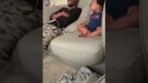
Child Development:
Serve and Return Builds Brains
Notes:
Talking Points/Facilitation Notes
Introduce the video (shows an everyday interaction between a father and son that demonstrates how simple Serve and Return can be)
Prompt participants to be thinking about where they see any of the 5 serve and return steps from the last video (review steps):
Share the focus
Support and encourage
Name it
Take turns back and forth
Practice endings and beginnings
Play the video
Ask participants to share out where they noticed the Serve and Return steps and any other things they noticed
Remind providers that it’s everyday activities that become opportunities for brain building
Ask participants what everyday activities they do with children that might be opportunities for brain building
Answers Should Include
*Read out any answers not listed by the group
Grocery Shopping Having meals together
Playing games Cleaning
Cooking Going to the park or playing outside together
Reading books Waiting in line
Video Link
https://www.youtube.com/watch?v=DOfEu2zqrkQ
Source
https://www.cdc.gov/ncbddd/actearly/milestones/index.html

Slide 15

Child Development Milestones
Social/Emotional
Physical/Movement
Language/Communication
Cognitive/Thinking
Approaches to Learning
Notes:
Talking Points/Facilitation Notes
Introduce developmental milestones by explaining that they are the skills seen in infants and children as they grow
Explain that children reach these milestones in how they play, learn, speak, act, and move their bodies
Share examples of milestones (skills such as taking a first step, smiling for the first time, and waving “bye bye,” pointing at objects)
Explain that there are five domains or groups of milestones that are used to help us understand how children develop
Ask participants for volunteers to share their knowledge of any of the five categories of developmental milestones
Social/Emotional
Physical/Movement
Language/Communication
Cognitive/Thinking
Approaches to Learning
Social/Emotional: This domain is about how children interact with others and express emotion
Physical/Movement: This domain is about how children use their bodies
Language/Communication: This domain is about how children express their needs and share what they are thinking, as well as understand what is said to them
Cognitive/Thinking: This domain is about how children learn new things and solve problems
It includes how children explore their environment to figure things out – whether by looking at the world around them, putting objects in their mouths, or dropping something to watch it fall
This domain also includes “academic” skills like counting and learning letters and numbers
Approaches to Learning: This domain is about how children learn and the ways in which they engage in learning
Approaches to learning incorporates the following:
Curiosity and Flexibility-children learn about themselves and the world around them
Play and imagination-children demonstrate increasingly complex play styles
Initiative, persistence, and problem solving--children engage in explorations and interactions with confidence
Self-Regulation—children develop an increasing ability to manage their emotions and behaviors
Remind providers that children develop at their own pace, so it’s impossible to tell exactly when a child will learn a given skill
Explain how the developmental milestones help us have a general idea of the changes to expect as a child grows
Introduce the “Milestone Tracker” app and explain how providers and families can download it from their app store
Reference binder for specific milestone information
Sources
https://www.cdc.gov/ncbddd/actearly/pdf/FULL-LIST-CDC_LTSAE-Checklists2021_Eng_FNL2_508.pdf
https://www.cdc.gov/ncbddd/actearly/milestones/index.html
https://www.cdc.gov/ncbddd/childdevelopment/facts.html
https://eclkc.ohs.acf.hhs.gov/school-readiness/effective-practice-guides/approaches-learning
https://www.michigan.gov/mileap/-/media/Project/Websites/mileap/Documents/Early-Childhood-Education/gsrp/standards/ECSQ-B-K_Final.pdf
Piaget’s Stages: 4 Stages of Cognitive Development & Theory (simplypsychology.org)

Slide 16
Child Development: Developmental Milestones
Activity
Read through the Milestone Moments or Positive Parenting School Age handouts that correspond with the ages of children in your care
What is important for us to know about children at this age?
What are some activities you could do with the children to support their development?
Notes:
Talking Points/Facilitation Notes
Introduce the paper copies of the developmental milestones ("Milestone Moments")
Explain how understanding milestone moments can help us plan interactions and activities to promote development in all five domains
Facilitate Developmental Milestones Activity
TIME LIMIT: 10 minutes (any group size)
Activity Goals
To help providers get familiar with milestones for the ages of the children they’re caring for
To prompt providers to think of activities that can support the development of the children they’re caring for
Explain the activity and review the questions on the slide
Have the participants review their handouts independently for a few minutes
In-Person:
Trainers can break participants into the following small groups according to the ages of children in their care
or have participants remain at their table and discuss with their tablemates, or facilitate as a whole group
Birth-12 months
13-24 months
3-5 years
6+ years
Have each group share out highlights with the larger group
Virtual:
CDC handouts/website linked in the text on the slide
Handouts
CDC Developmental Milestones
Positive Parenting Tips for Healthy Child Development (Middle Childhood)
Sources
https://www.cdc.gov/ncbddd/actearly/milestones/index.html
0-5 Checklist: https://www.cdc.gov/ncbddd/actearly/pdf/FULL-LIST-CDC_LTSAE-Checklists2021_Eng_FNL2_508.pdf
Schoolagers: Positive Parenting Tips | Child Development | CDC
(scroll down to see age ranges)​
https://www.cdc.gov/ncbddd/actearly/milestones/index.html

Slide 17
Child Development:
Concerns About Development
Use the milestones to help identify possible delays
Share what you are observing with the child’s family
Encourage the parent or guardian to contact the child’s health care provider about any concerns
Early On
Build Up
www.1800earlyon.org
1-800-327-5966
www.buildupmi.org
1-888-320-8384
Notes:
Talking Points/Facilitation Notes
Explain the possibility of becoming concerned about the lack of progress a child is making
Share that 70% of children with developmental disabilities and mental health problems are not identified until school entry
Explain the importance of early intervention: the earlier a child-in-need receives specialized support, the less impact a delay can have on that child’s future development and learning and connect to the provider’s role
Introduce the steps providers can take if they have concerns about development by reviewing the points on the slide:
Use developmental milestones to help identify possible delays
Share what you’re observing with the child’s family
Explain that both providers and parents can make a referral, but we recommend talking with the family first as it will always be their decision whether to accept services if the child qualifies
Encourage the parent or guardian to contact the child’s health care provider about any concerns
Explain Early Intervention Services
Early On and Build Up Michigan offer free services for children to support their health and development
Early On serves children from birth to age 3 (have participants flip to this flyer)
Build Up Michigan serves children up to age 5 (have participants flip to this flyer)
For older children, parents should seek services through the child’s school district
If relevant for the community you are training in, explain the ASQ and what local resources are available
If relevant for the community you are training in, explain Help Me Grow
Ask providers what questions they might still have about child development
Handouts
Early On Flyer
Build Up Flyer
Source
https://nrckids.org/cfoc/database/2.1.1.4

Slide 18
Prevention of Child Maltreatment, Abusive Head Trauma, and Shaken Baby Syndrome
Notes:
Talking Points/Facilitation Notes
Introduce Prevention of Shaken Baby Syndrome, Abusive Head Trauma and Child Maltreatment

Slide 19
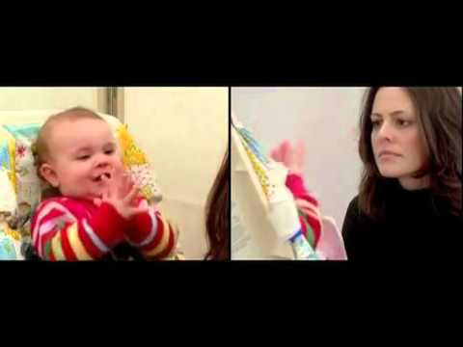
Prevention of Child Maltreatment
Notes:
Talking Points/Facilitation Notes
Introduce the video by explaining that because human beings need connection to thrive, we experience stress when we try to connect but don’t get a response – we can see this even in very young children
Remind providers that because children’s brains are vulnerable and growing, this stress can negatively impact their development and its effects can last the entire life span
Play the video
Ask providers to share what stood out to them from the video
Video Link
https://youtu.be/apzXGEbZht0
Sources
https://developingchild.harvard.edu/resources/experiences-build-brain-architecture/
https://46y5eh11fhgw3ve3ytpwxt9r-wpengine.netdna-ssl.com/wp-content/uploads/2016/05/8-Things-to-Remember-About-Child-Development.pdf
https://dhss.alaska.gov/ocs/Pages/childrensjustice/reporting/why_brain.aspx
https://www.childtrends.org/indicators/child-maltreatment

Slide 20
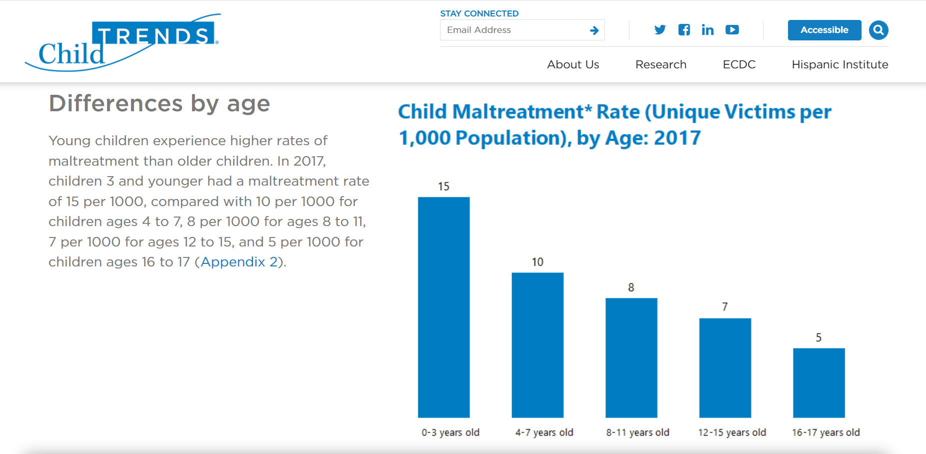
Prevention of Child Maltreatment
Notes:
Talking Points/Facilitation Notes
Share with providers that even though the youngest children (0-3) are the most vulnerable to the impacts of abuse, data shows that they experience the highest rate of maltreatment
Stress the importance of providers’ roles in preventing child maltreatment

Slide 21
Prevention of Child Maltreatment: Appropriate Guidance
The State of Michigan manual for licensed childcare providers prohibits the following means of punishment: hitting, spanking, shaking, biting, pinching, restricting movement, and inflicting emotional or mental harm.
Children deserve to be treated respectfully and appropriately in a positive manner. Research has linked mental and emotional stress and corporal punishment with negative effects such as learning issues and later criminal behavior.
Notes:
Talking Points/Facilitation Notes
Introduce guidance in caring for children by explaining that having appropriate expectations for children’s behavior is a primary way to prevent child maltreatment
Explain that some forms of punishment that have proven to be harmful to children and are prohibited for childcare providers
Read the slide
Explain that children require different strategies for guidance based on their age and developmental abilities
Provide examples and include mention of children with special needs
(Example: how you guide a 12-year-old would look different than how you would guide a 2-year-old or a 16-year-old with special needs)
Share with providers that next you will discuss ways to help guide children through positive interactions
Sources
State of Michigan Child Care Center Rules – Technical Assistance and Consultation Manual
https://eclkc.ohs.acf.hhs.gov/health-services-management/caring-our-children-basics/prohibited-caregiverteacher-behaviors
https://www.michigan.gov/documents/lara/Home_Technical_Assistance_and_Consultation_Manual_-_Effective_1_1_16_509880_7.pdf

Slide 22
Prevention of Child Maltreatment: Appropriate Guidance
Make sure the space is ready
Model the behaviors and language you want to see
Tell children what you want them to do
Redirect the child to a positive choice
Ignore behaviors when appropriate
Remove the child from the situation
Notes:
Talking Points/Facilitation Notes
Remind providers that children have a different perspective of the world than adults do and that being proactive is an important guidance strategy
Encourage providers to have a plan for how they will respond to different behaviors and to communicate those outcomes to the children
Review the points on the slide:
Explain how making sure the space is ready ahead of time can reduce opportunities for challenging behavior
(examples: move breakable items out of reach, keep areas like the bathroom closed or blocked off during care)
Model the behaviors and language you want to see
Children learn how to behave from what they see, not just what they’re told
Tell children what you want them to do
(provide examples: “please walk” rather than “don’t run,” or “let’s build with the blocks” instead of “don’t throw the blocks”)
Redirect the child to a positive choice
(provide examples: could be used when a child wants a toy another child has - offer another toy first and assure the child they’ll get a chance to play with the desired toy when the other child is finished or explaining that a toddler who “gets into everything” needs more than being told “no” – redirect them to something else to explore)
Ignore behaviors when appropriate
(provide examples: you don’t want to ignore children hitting one another, but perhaps you may choose to ignore a child saying “poopy butt”)
Remove the child from the situation
If a child continues inappropriate behaviors during an activity, remove the child from that activity for a period of time and redirect them to another activity
Source
Best Practices for Guiding Children’s Behavior

Slide 23
Prevention of Child Maltreatment:
Have a Plan When You’re Feeling Stressed
Know it is okay to ask for help
Have easy access to parent phone number and other support people
Know that it is okay to let an infant or toddler cry – if the child is safe
Step into another room and breathe
Notes:
Talking Points/Facilitation Notes
Discuss the realities of stressful situations when caring for children of any age
Explain the importance of self-awareness - understanding what situations or behaviors cause the most stress for us individually and having a plan for when we’re stressed or overwhelmed
Review the points on the slide:
Know it is okay to ask for help
Have easy access to parent phone number and other support people
Know that it is okay to let an infant or toddler cry - if the child is safe
Step into another room and breathe
Ask providers to share one way that they relieve stress with the group
Ask providers what questions they might still have about prevention of child maltreatment

Slide 24

Prevention of Abusive Head Trauma including Shaken Baby Syndrome
Abusive Head Trauma (AHT) is a type of physical abuse towards an infant or child that results in a head or neck injury
Most cases of AHT happen when a parent or caregiver is upset because a baby or child won’t stop crying or isn’t doing something they expect the child to do
The injuries from AHT can result in long term physical, mental and medical deficits, brain damage, and even death
There are around 3,000 cases of AHT in the U.S. each year, with 1 out of 4 children dying from the injuries.
No amount of shaking is safe
Notes:
Talking Points/Facilitation Notes
Share with providers the information on this slide to help them realize how serious AHT is.
Introduce the topic of shaken baby syndrome or abusive head trauma
Review the points on the slide:
Explain that these injuries happen when someone (most often a parent or other caregiver) vigorously shakes a child or strikes the child's head against a surface
Discuss how sometimes a caregiver can't get a baby to stop crying and shakes them out of frustration or anger
Stress that these actions can cause damage to the brain, eyes, ribs and can even cause death
Ask providers if they have any ideas about why babies might be easy to injure in this way
Answers Should Include
**Read out any answers not listed by the group
Babies’ heads are heavy and large in proportion to their body size
Babies have weak neck muscles
Babies have fragile, undeveloped brains
There is a large size and strength difference between the baby and the adult
Explain that, unfortunately, shaking a baby may have the desired effect; the baby cries more at first, but may stop crying as a result of brain damage
Explain that no amount of shaking is ever safe
Sources
https://www.dontshake.org/learn-more
https://kidshealth.org/en/parents/shaken.html

Slide 25
Prevention of Abusive Head Trauma including Shaken Baby Syndrome
ABUSIVE HEAD TRAUMA IS RESULT OF ONE OF THREE ACTIONS
Someone uses force to throw or drop a baby or child on purpose
Someone hits the child’s head or neck against an object, like the floor or furniture, or hits the child’s head or neck with an object
Someone uses force to shake a baby or child. This is the form of Abusive Head Trauma known as Shaken Baby Syndrome
NEVER, NEVER shake a baby! No amount of shaking is safe.
Notes:
Talking Points/Facilitation Notes
This slide describes the 3 actions that result in Abusive Head Trauma.
Explain to participants that in the past individuals addressed Shaken Baby Syndrome. Although it is a very serious action and responsible for the majority of Abusive Head Trauma, it is important that we are aware of the other actions that cause Abusive Head Trauma. Therefore, they will hear the term Abusive Head Trauma used more now instead of Shaken Baby Syndrome because it encompasses all of the causes.
Tell participants to share with families that they should NEVER shake a baby.

Slide 26
Recognition and Reporting of Child Abuse and Neglect
Notes:
Talking Points/Facilitation Notes
Introduce Recognition and Reporting of Child Abuse and Neglect

Slide 27
Recognition and Reporting of Child Abuse and Neglect
As a License Exempt Provider, you are committing to understanding your role as a Mandated Reporter
Know the signs of abuse and neglect
Michigan Department of Health and Human Services Centralized Intake
  Open 24 hours a day, 7 days a week
  Report by phone or online
    855-444-3911
Notes:
Talking Points/Facilitation Notes
Introduce this slide by explaining that part of ensuring children stay safe and healthy is being able to recognize and report child abuse and neglect
Review the points on the slide:
Share with providers that, by becoming a License Exempt Provider, they are committing to understanding their role as a Mandated Reporter
(explain what this is – a person required by the Child Protection Law to report suspected child abuse or neglect to MDHHS, not just for the children in their care but for all children they have contact with)
Stress the importance of the role of Mandated Reporters in protecting children - reports made by mandated reporters are confirmed at nearly double the rate of those made by non-mandated reporters
Explain the importance of knowing the signs of abuse and neglect
Have providers open the Mandated Reporter guide to the page showing signs of abuse and neglect and the categories (page 8-9)
Name each category: Physical Abuse, Physical Neglect, Sexual Abuse, Medical Neglect, Maltreatment, Human Trafficking
Read or have providers volunteer to read out a couple of physical and behavioral indicators for each one
Stress the importance of making the call if there are concerns, even when providers feel uncertain if abuse or neglect is happening
Share the MDHHS Centralized Intake phone number and explain how to report: online or by phone - reporting is always confidential and Centralized Intake is open 24 hours a day, 7 days a week
Share that if providers call in a report, a written report must be mailed or faxed to MDHHS within 72 hours
Share that if providers choose to report online, there is no need to report by phone or mail/fax the written report
Ask providers what questions they might still have about recognizing and reporting child abuse and neglect
Sources
https://www.michigan.gov/mdhhs/0,5885,7-339-73971_7119_50648_44443---,00.html
(mandated reporter website with link to guide)
https://www.michigan.gov/documents/mdhhs/Mandated_Reporter_Training_Guide_727442_7.pdf
https://www.michigan.gov/mdhhs/0,5885,7-339-73971_7119_50648_44443_91424---,00.html (MDHHS website with guidance for reporting online)

Slide 28
Types of Child Abuse & Neglect Descriptions & Signs & Symptoms of Each
NEGLECT Physically ignoring a child’s needs, failure to protect or improper supervision which place a child at risk or in danger | Child suffers from chronic dental or medical issues. Child lacks sufficient clothing for the weather. Parents abuse alcohol and/or other drugs. Child begs or steals food or money. Child is consistently dirty and has body odor.
MENTAL INJURY A pattern of acts like name calling, belittling, screaming at, blaming, or withholding affection that results in psychological damage | Child demonstrates extremes in behavior, like very passive or aggressive, compliant or demanding Child is delayed in physical and/or emotional development Parent is unconcerned about or rejects child Child displays inappropriate adult or infantile behavior
CHILD MALTREATMENT Treatment of a child that involves cruelty or suffering. It could be harsh punishment or public humiliation | Child is fearful and insecure Obvious signs of maltreatment, like the child is forced to wear a sign saying that they wet the bed Similar signs as child suffering from mental injury
SEXUAL ABUSE Can involve touching or penetrating the child’s intimate parts or soliciting child to perform sexual acts | Child has itching, pain, bleeding, or bruising in the genital area Child has difficulty walking or sitting Child demonstrates inappropriate, bizarre, or sophisticated sexual knowledge or behavior Child has frequent yeast or urinary infections Parents are unduly protective of child
PHYSICAL ABUSE A non-accidental injury to a child that the parent can’t explain; could involve burning, beating, kicking, punching; could cause Abusive Head Trauma, internal injuries, death | Frequently have particular patterns, like line of burns Injuries typically on both sides of the body, as in bruises on both arms from a child being grabbed Parents delay talking about injury hoping no bruises will appear Parents are hesitant to take the child in for medical care See TEN-4-FACESp Bruising Rule on following slide
Notes:
Talking Points/Facilitation Notes
Explain the importance of knowing the signs of abuse and neglect
Tell providers they have the same information from the slide in the Mandated Reporter guide showing signs of abuse and neglect and the categories (page 8-9)
Name each category: Physical Abuse, Physical Neglect, Sexual Abuse, Medical Neglect, Maltreatment, Human Trafficking
Human Sex Trafficking and Sexual Exploitation are forms of Sexual abuse. Child Sex Trafficking means to recruit, entice, harbor, transport, provide, or obtain by any means a minor for commercial sexual activity.
Read or have providers volunteer to read out a couple of physical and behavioral indicators for each one, either from the Resource Packet or from the slide
Stress the importance of making the call if there are concerns, even when providers feel uncertain if abuse or neglect is happening
Sources
https://www.michigan.gov/mdhhs/0,5885,7-339-73971_7119_50648_44443---,00.html
(mandated reporter website with link to guide)
https://www.michigan.gov/documents/mdhhs/Mandated_Reporter_Training_Guide_727442_7.pdf
https://www.michigan.gov/mdhhs/0,5885,7-339-73971_7119_50648_44443_91424---,00.html (MDHHS website with guidance for reporting online)

Slide 29
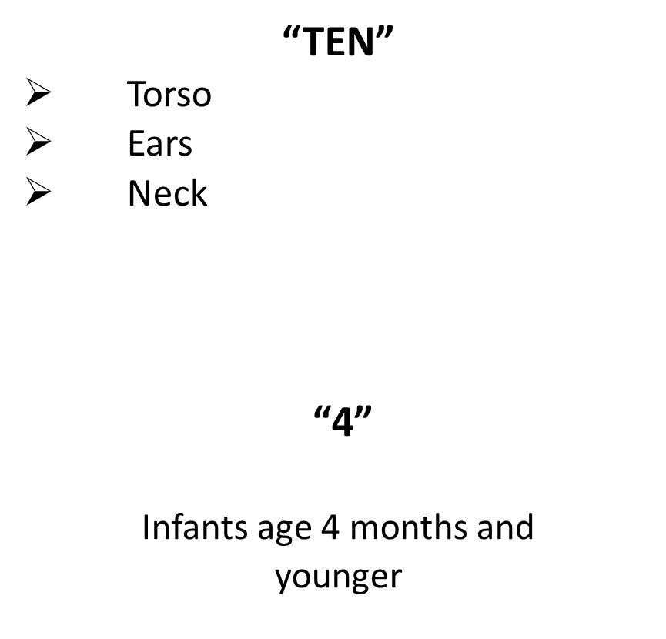
TEN-4- FACESp Bruising Rule
“FACES”
  Frenulum (Inner part of gum near teeth)
  Angle of Jaw (jawline)
  Cheeks (fleshy part)
  Eyelids
  Subconjunctivae (white part of eye)
  “p”
  Patterned bruising (Specific patterns like slap, grab, cigarette burns)
Notes:
Talking Points/Facilitation Notes
Kids can play in ways that may result in minor cuts, scrapes, and bruises. These are often found on the bony areas of the body like knees, shins, elbows, and forehead. There are other types of bruises that should be a red flag for possible abuse. The TEN-4-FACESp screening tool is for use with children under 4 to identify when a bruise is more likely to have been caused by abuse. Please note that this is a screening tool to identify when to suspect abuse and make a Children’s Protective services referral. It does not diagnose abuse.
All of the items listed on this page are reason for concern and suspicion of child abuse.
“TEN”- This signifies that a bruise on any of these 3 areas on a child under 4 years old warrants suspicion- the Torso, the Ears, and the Neck.
“4”- This notes that any bruise on an infant 4 months and younger, or an infant that is not mobile is a red flag to suspect abuse.
“FACES”- Any abuse in the following areas is reason for suspicion of abuse: Frenulum (Inner part of gum near teeth), the Angle of the Jaw, the fleshy parts of the cheeks, the Eyelids, and the Subconjunctivae (white part of eye).
“p”- any pattern of bruises is reason for suspicion. An example of this would be a row of cigarette burns.
Tell participants that the use of this tool can help identify abuse early before it escalates and results in tragedy.

Slide 30
Prevention of Sudden Infant Death Syndrome and the Use of Safe Sleep Practices
Notes:
Talking Points/Facilitation Notes
Introduce Prevention of Sudden Infant Death Syndrome and Safe Sleep Practices by sharing that sleep-related deaths are the leading cause of death among infants 1 month to 1 year of age
Explain that sleep related deaths are those where the sleep environment (blankets, pillows, people, pets, etc.) likely contributed to the death
Stress that most sleep‐related deaths are preventable
Source
https://www.michigan.gov/documents/mdhhs/Sleep-Related_Infant_Death_Infographic_726782_7.pdf

Slide 31

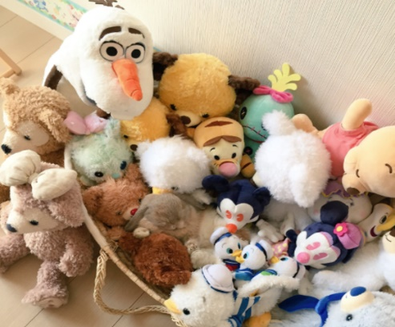
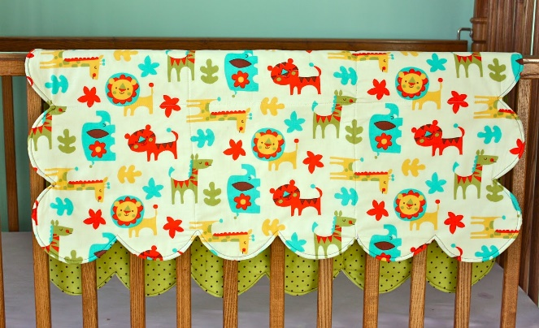

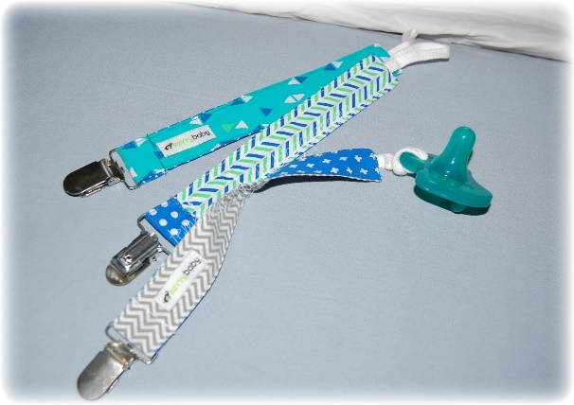

What Belongs in the Sleeping area?
Notes:
Talking Points/Facilitation Notes
Introduce this slide by explaining that it contains six common items you might find in a baby’s crib
Move from item to item and ask providers to give a thumbs up if they believe it’s a safe item or a thumbs down if they believe it’s not safe
(adjust the signal based on the abilities within the group)
Explain that each of these items presents a strangulation and/or suffocation hazard and are no longer considered a safe part of a baby’s sleeping area
Sources
https://www.michigan.gov/mdhhs/0,5885,7-339-71548_57836---,00.html
https://www.marchofdimes.org/baby/safe-sleep-for-your-baby.aspx (not sleeping in carriers, slings, car seats, strollers etc.)

Slide 32
Prevention of Sudden Infant Death Syndrome and the Use of Safe Sleep Practices
Alone on back
In crib, bassinet or pack-n-play
On a firm mattress with a tightly fitted sheet
No pads, blankets, wedges, or positioners
In the same room as an adult
Notes:
Talking Points/Facilitation Notes
Introduce this slide by explaining that what’s considered safe for a baby’s sleep environment has changed over time
Stress to providers their responsibility as a License Exempt Provider to practice safe sleep requirements while providing care and explain that when they submit hours of care to CDC billing, they are confirming their use of these practices
Review the points on the slide:
Babies should sleep alone on their backs in a crib, portable crib, bassinet or pack ‘n play (play yard) with only a firm mattress and tightly fitted sheet for every sleep time
Stress that no pillows, pads, blankets, wedges, positioners, comforters, stuffed animals or other objects should be in the baby’s sleep area (other objects may include headbands and pacifier with straps)
Stress the reality that many caregivers worry about a baby being too cold, but the risk of overheating is serious
Explain that infants who are the right temperature have a warm back of the neck and chest, but might still have cool hands or feet
Remind providers that the baby should sleep where they can see and hear them (in the same room as the adult) – share the room, not a bed
Remind providers that supervised tummy time is important and recommended daily because it strengthens babies’ muscles, helping them gain more control over pushing themselves up and holding up their head
Share that tummy time should begin soon after hospital discharge and increase incrementally to at least 15 to 30 minutes total daily by 7 weeks of age
Sources
https://www.michigan.gov/mdhhs/0,5885,7-339-71548_57836_69566-165976--,00.html
https://www.cdc.gov/vitalsigns/safesleep/infographic.html#infographic
https://publications.aap.org/pediatrics/article/doi/10.1542/peds.2022-057990/188304/Sleep-Related-Infant-Deaths-Updated-2022?autologincheck=redirected

Slide 33

Prevention of Sudden Infant Death Syndrome and the Use of Safe Sleep Practices: Choking
Notes:
Talking Points/Facilitation Notes
Introduce the video by explaining that one of the most common concerns that parents and providers express about having infants sleep on their backs is that they will choke if they spit up
Explain that this short video shows why that is unlikely to happen
Play the video
Review the information in the video by explaining that when a baby is their back, the air tube is on top of the food tube
Share that when a baby spits up, the liquid flows back into the stomach, not the lungs – on the other hand, when a baby is on their stomach, fluid can pool at the opening of the air tube and may cause choking
Share that another common question that comes up is whether a baby can stay sleeping on their stomach if they roll over during sleep time
Explain that once the baby can roll from back to stomach and from stomach to back, the baby can be allowed to remain in the sleep position that they choose
Stress the importance of every baby starting every sleep time on their back
Video Link
https://www.youtube.com/watch?v=uK84x2FE3fg
Sources
https://www.michigan.gov/mdhhs/0,5885,7-339-71548_57836---,00.html
(https://www.marchofdimes.org/baby/safe-sleep-for-your-baby.aspx) (not sleeping in carriers, slings, car seats, strollers etc.)
https://safetosleep.nichd.nih.gov/safesleepbasics/faq
https://publications.aap.org/pediatrics/article/doi/10.1542/peds.2022-057990/188304/Sleep-Related-Infant-Deaths-Updated-2022?autologincheck=redirected

Slide 34
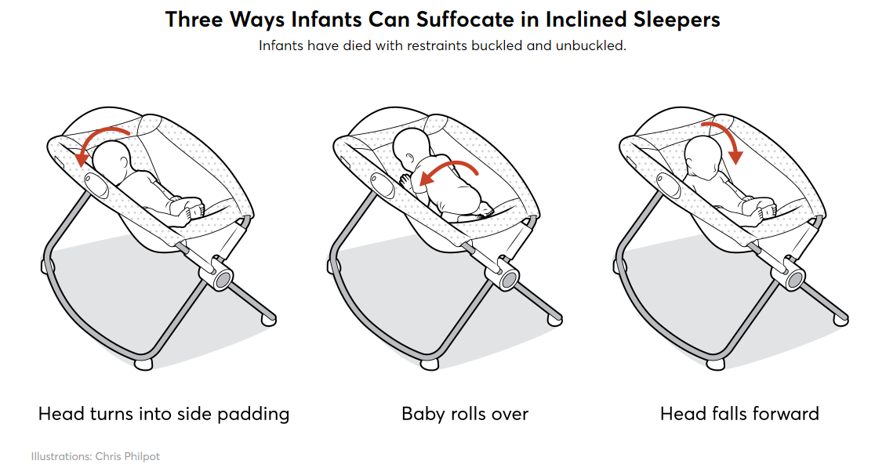
Prevention of Sudden Infant Death Syndrome and the Use of Safe Sleep Practices
Notes:
Talking Points/Facilitation Notes
Introduce the final slide in this section by explaining that car seats, swings and other sitting devices are not recommended for routine sleep
Reference the information on the slide and explain that the baby’s head can turn in towards the side padding or they could roll over, causing them to suffocate
Reference the last picture by sharing that car seats, swings, and other sitting devices are usually tilted forward (inclined)
Explain that the incline can cause the baby’s head to fall forward in a way that obstructs the airway
These risks are all reasons why the most recent safe sleep recommendations state that the baby's sleep surface should be non-inclined (flat)
Explain that if a baby falls asleep in a swing, bouncy seat, car seat, or other sitting device, they should be moved to a crib, bassinet, or pack ‘n play as soon as possible because these surfaces are non-inclined (flat) and are the safest for sleep
Finally remind providers that all children are different, and that children with specific disabilities or chronic illnesses may need different care while sleeping and napping
Explain that in these cases, providers should ensure they have documentation from the child’s medical team
Ask providers what questions they might still have about safe sleep practices
Sources
https://www.michigan.gov/mdhhs/0,5885,7-339-71548_57836---,00.html
https://www.marchofdimes.org/baby/safe-sleep-for-your-baby.aspx) (not sleeping in carriers, slings, car seats, strollers etc.
https://www.consumerreports.org/child-safety/while-they-were-sleeping/

Slide 35

Break
Please return in 5 minutes
Notes:
Talking Points/Facilitation Notes
To use as determined by the trainer

Slide 36
Building and Physical Premises Safety
Notes:
Talking Points/Facilitation Notes
Introduce Building and Physical Premises Safety (Including the Identification of and Protection from Hazards, Bodies of Water, and Vehicular Traffic)

Slide 37
Building and Physical Premises Safety: Serious Injury
“Unintentional injuries—such as those caused by burns, drowning, falls, poisoning and road traffic—are the leading cause of morbidity and mortality among children in the United States.”
-Center for Disease Control (CDC)
Notes:
Talking Points/Facilitation Notes
Introduce the topic of serious injuries by reading the quote on the slide
Share with providers that one of their responsibilities while providing care is to help prevent serious injuries and have a plan for what to do if they occur
Explain that during CPR and First Aid providers will learn how to assess and treat different injuries and illnesses but first we’ll talk about prevention

Slide 38

Building and Physical Premises Safety: Supervision
Children under age six should always be supervised directly by sound and sight
Even when children are napping, make visual checks
Notes:
Talking Points/Facilitation Notes
Introduce supervision when caring for children and explain how it’s related to health and safety
Explain active supervision: focused attention and intentional observation of children
Review the points on the slide:
Share that children under the age of six should always be supervised directly by sound and sight
Explain that even when children are napping, providers should make visual checks
(children under 1 require these checks every 15 to 20 minutes while they are sleeping and physically checking is best practice: do not rely on a monitor)
Discuss how supervision looks different depending on the age and developmental abilities of the child
Ask providers:
What might active supervision look like for an infant? Preschooler? School aged child? Teenager? A child with special needs?
(Use the ages/abilities of the children your providers will be caring for to guide the discussion)
Provide more examples as needed
Facilitate discussion around how providers might ensure active supervision if they need to use the restroom or take a phone call or prepare a meal in the kitchen
What actions might they take to keep children safe at these times?
Sources
https://eclkc.ohs.acf.hhs.gov/safety-practices/article/active-supervision#:~:text=What%20is%20Active%20Supervision%3F,and%20listening%20at%20all%20times.&text=This%20constant%20vigilance%20helps%20children%20learn%20safely
https://www.acf.hhs.gov/sites/default/files/documents/ecd/caring_for_our_children_basics.pdf
https://www.healthychildren.org/English/health-issues/conditions/prevention/Pages/Prevention-In-Child-Care-or-School.aspx
https://www.cdc.gov/safechild/child_injury_data.html
https://www.webmd.com/parenting/childrens-illnesses-which-ones-contagious#1
https://www.cdc.gov/headsup/pdfs/parents/headsup_playground_safety_fs-a.pdf?CDC_AA_refVal=https%3A%2F%2Fwww.cdc.gov%2Fsafechild%2Fplayground%2Findex.html

Slide 39
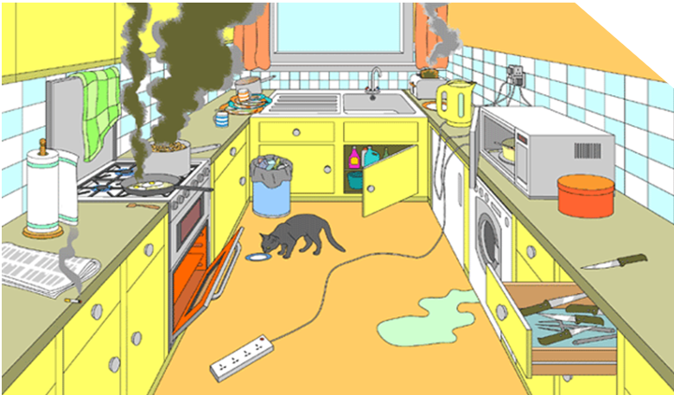
What hazards do you see?
Activity
Notes:
Talking Points/Facilitation Notes
Introduce common household hazards
Discuss how one of the best ways to avoid emergencies and accidents is to make sure an environment is safe to begin with
Facilitate Hazard Activity
TIME LIMIT: 5 minutes (any group size)
Activity Goals
To engage providers in identifying potential hazards in the home
Ask for volunteers to share out the hazards they see in this picture
Answers Should Include
*Point out any hazards that aren’t listed by the group
Lit cigarette on the counter near flammable items
Towel hanging on the back of the oven
Water on the floor
Surge protector on the floor
Overloaded outlet
Food burning on the stove
Burning food in toaster
Pot and pan handles turned out where children can reach and pull them down
Oven is on and the door is open
Knife out on counter
Knife drawer open
Metal utensil in the microwave
Cleaning supplies accessible via open cupboard
Garbage and leftover food on the counter
Open trash can
Source
https://www.redcross.org/get-help/how-to-prepare-for-emergencies/types-of-emergencies/fire/is-your-home-a-fire-hazard.html

Slide 40
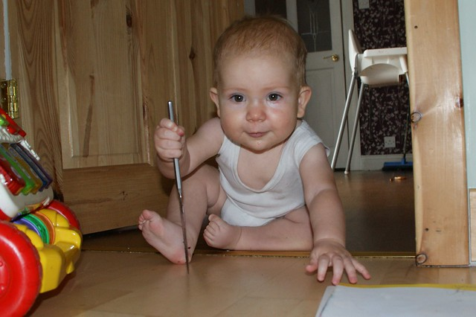


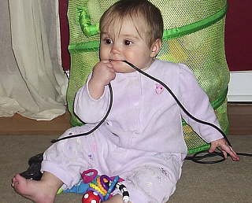
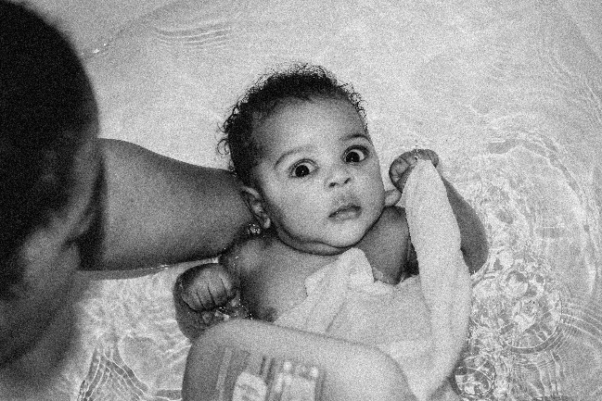
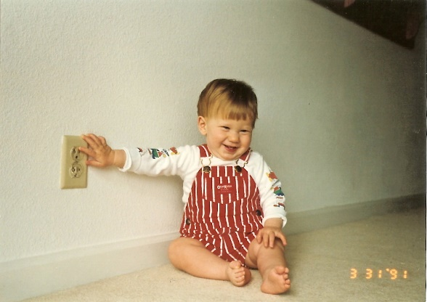
Building and Physical Premises Safety:
Indoor Hazards
Notes:
Talking Points/Facilitation Notes
Guide participants to look at the pictures on the screen and think about the area(s) where they will be providing care
Ask for volunteers to share out rooms or areas
Prompt them to think about common areas of access: living room, bedrooms, bathrooms, closets and cupboards, laundry rooms, basements, garages
Prompt them to think about the kinds of activities that children engage in
Ask participants to share out potential hazards in their areas of care, based on the ages and activities of the children they will be providing care for
Answers Should Include
*Read out any answers not listed by the group
Window and toy cords pose risk of strangulation
Cords can be tripping hazards or could be used by a child to pull something down on top of them
Outlets
Plastic bags
Matches, lighters, and candles
Guns and other weapons
Storage of chemicals and tools in attached garages
Screen time
Burn/scald risks from hot water and from radiator heaters
(120 degrees is the recommended water heater temperatures by from the Consumer Product Safety Commission)
Space heaters
Tipping furniture (TVs on dressers, lamps on nightstands or tables)
Exposed wiring, surge protectors with many things plugged in
Water
Review water safety
Explain that children can more easily drown because their head is much larger in proportion to their body
For example, a child could tip into a bucket of water and be unable to pull themselves out
Explain that children can drown in less than two inches of water and that drowning is typically quiet
Remind providers to get rid of any standing water in buckets, bins, or pots
(drain the bathtub immediately, keep lids down on toilets, restrict access to bathrooms and laundry rooms)
Firearm Safety- Teach children never to touch guns, even if it looks like a toy, and to tell an adult immediately if they find a weapon.
For more on firearm safety, please visit
Firearm Safety
Sources
https://www.safekids.org/infographic/facts-about-kids-and-danger-drowning
https://www.safekids.org/sites/default/files/documents/water_safety_tips_0.pdf

Slide 41
Building and Physical Premises Safety: Outdoor Play
Anchors children to the real world
Social interactions
STEM skills
Taking appropriate risks
New context for learning
Opportunities for collaboration
Promotes better sleep
Notes:
Talking Points/Facilitation Notes
Introduce this slide by explaining that physical activity and outdoor play are important for a child’s healthy development
Remind providers that this includes infants and toddlers
Share that best practice is, when weather permits, to offer daily active outdoor play in every season
Ask providers why they think outdoor play might be important for a child’s development?
Answers Should Include
*Read out any answers not listed by the group
It invites children to learn STEM skills
It creates opportunities for social interaction and collaboration
It promotes physical health
It invites new contexts for learning
It promotes better sleep
It gives children a chance to take appropriate risks
It may lead to better learning outcomes once children return to other activities
It anchors children to the real world
Source
https://www.naeyc.org/resources/pubs/yc/may2019/outdoor-play-is-essential

Slide 42
Building and Physical Premises Safety: Outdoor Hazards
Sun protection
Animal bites
Water safety
Notes:
Talking Points/Facilitation Notes
Introduce this slide by explaining outdoor hazards and encourage providers to talk with the family about their rules related to safety outdoors
Remind providers to set their own boundaries for safety during the time of care if there’s anything they’re uncomfortable with
Review the hazards on the slide:
Highlight the importance of continuing active supervision while outdoors
Ask providers what ideas they have about how to protect children from the sun
Answers Should Include
*Read out any answers not listed by the group
Stay in the shade
Wear sunhats
Wear sunglasses
Dress children in fabrics that are not see-through to protect the skin
Apply sunscreen often and in the right amount (for all skin tones, on all exposed areas – follow directions on container)
Monitor children for signs of dehydration (fussiness, redness, excessive crying)
Discuss the danger of animal bites
Stress the importance of gaining knowledge of the animals in the area or neighborhood
Encourage providers to teach children to never approach animals without checking with an adult first
Ask providers what ideas they might have about how to keep children safe around water outside
Answers Should Include
*Read out any answers not listed by the group
Keep children within arms’ length when there is water around
Ensure that children cannot access a pool, pond, or other body of water where you provide care
(best practice is for the pool to have a self-latching gate and be surrounded by a 4-foot fence)
Discuss yard safety by explaining the importance of walking through the area to ensure there are no hazards (broken glass, tripping hazards, trash/garbage, etc.) before children play there
Encourage providers to gain knowledge of where any chemicals, lawn and car supplies, and tools are and ensure children cannot access them
Remind providers of the importance of wearing helmets and other protective gear when riding bikes, trikes, scooters and other equipment
Sources
https://www.safekids.org/infographic/facts-about-kids-and-danger-drowning
https://www.safekids.org/sites/default/files/documents/water_safety_tips_0.pdf
https://www.epa.gov/sites/production/files/documents/actionsteps.pdf
https://playgroundsafety.org/sites/default/files/2018-11/npps-report-card.pdf
https://www.fda.gov/consumers/consumer-updates/should-you-put-sunscreen-infants-not-usually
https://www.parents.com/kids/safety/outdoor/sun-care-basics/

Slide 43
Building and Physical Premises Safety: Outdoor Hazards
Traffic, driveways, and parking lots
Weather
Playground
Notes:
Talking Points/Facilitation Notes
Introduce this slide by continuing the discussion of outdoor hazards
Review the hazards on the slide:
Discuss the dangers that traffic, driveways, and parking lots pose to children
Explain that many children cannot be seen in the rearview mirror or in front of the car because of their height
Share that some children don’t experience a sense of danger around vehicles and stress the importance of teaching children to stay away from parked cars and to ask an adult for help if a toy rolls under a vehicle
Tell providers that by removing toys from driveways or parking lots, they can help lower the risk of children being backed over
Reference the Weather Chart in the and encourage providers to use it to learn what temperatures are safe for outdoor time
Discuss the importance of children being dressed appropriately for the weather and staying hydrated no matter the temperature
Ask providers what things might be important to think about when taking children to the playground
Answers Should Include
*Read out any answers not listed by the group
Age-appropriate play equipment (a playground should have a separate area for children under 5)
Hazards like rusted or broken playground equipment (inspect equipment before children use it)
Trash in the play area (pop cans, broken glass, etc.)
Appropriate clothing (necklaces, scarves, and drawstrings can get caught and pose a strangulation hazard)
Handout
Weather Guide for Outdoor Play (https://www.child-daycare-directory.com/wp-content/uploads/childcare-weather-watch-chart.jpg)
Sources
https://child-daycare-directory.com/resources/childcare-weather-watch/
https://playgroundsafety.org/sites/default/files/2018-11/npps-report-card.pdf

Slide 44
Building and Physical Premises Safety: Lead
Paint
Water
Notes:
Talking Points/Facilitation Notes
Introduce this slide by explaining that knowledge of possible environmental hazards is important to keeping children safe
Share with providers that lead is the most common environmental hazard, but is 100% preventable
Stress that no amount of lead is safe for consumption – even one paint chip has enough lead to poison a child
Explain that children between the ages of 6 months and 6 years and pregnant women are most at risk, and that there are two potential sources of lead that are important to be aware of
Paint
Explain that houses built before 1978 are more likely to have lead-based paint, which is poisonous
Water
Explain that lead pipes can be impacted over time in ways that cause the lead from the pipes to enter the water and cause it to be poisonous
Stress the importance of taking children 12 months and older to their physician to be tested for lead, especially if there has been suspected exposure
Share with providers that the only treatment for lead exposure is to remove the child from the source of lead that is poisoning them
Highlight community resources relating to lead as applicable
Sources
https://www.mayoclinic.org/diseases-conditions/lead-poisoning/diagnosis-treatment/drc-20354723Citation for soil: https://www.mibluecrosscomplete.com/resources/lead-screenings/
https://www.cdc.gov/nceh/lead/prevention/sources/soil.htm

Slide 45
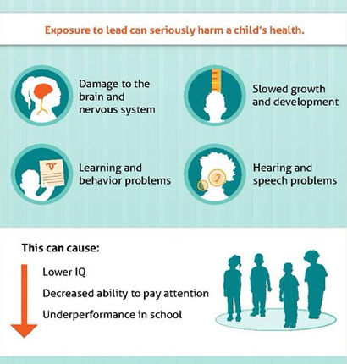
Building and Physical Premises Safety: Lead Exposure
Notes:
Talking Points/Facilitation Notes
Explain that it’s important to understand that exposure to lead can seriously harm a child’s health
Review the graphic on the slide:
Exposure to lead can cause
Damage to the brain and nervous system
Learning and behavior problems
Slowed growth and development
Hearing and speech problems
This can cause
Lower IQ
Decreased ability to pay attention
Underperformance in school
Ask providers what questions they might still have about lead exposure and indoor or outdoor hazards
Sources
Well fed means less lead
https://www.nationaleatingdisorders.org/learn/by-eating-disorder/other/pica
Infographic: https://www.cdc.gov/nceh/lead/prevention/infographic-lead-exposure.htm

Slide 46
Building and Physical Premises Safety: Smoking Cigarettes & Vaping E-cigarettes
Cigarettes contain nicotine and tobacco.
E-cigarettes contain nicotine and other harmful chemicals.
Secondhand smoke in cigarettes is proven to cause cancer, heart disease, and lung disease.
The nicotine in secondhand smoke from cigarettes and aerosol from e-cigarettes can affect brain development.
The other chemicals found in the ultrafine particles of e-cigarettes may cause lung disease, heart disease, and cancer.
Children are also at risk of ingesting the chemical pod cartridges or getting burnt from cigarettes and e-cigarettes.
Residual chemicals on surfaces can also impact the health of children.
NEVER vape or smoke around children or in areas where they are being cared for.
Notes:
Talking Points/Facilitation Notes
Review the information on the slide.
Explain how research has been out for many years on the dangers of secondhand smoke from cigarettes. Tens of thousands of deaths annually are the result of it. Although research continues to need to be done on the effects of vaping, e-cigarettes contain nicotine which can harm the developing brain. Since they are not regulated, they also include many harmful chemicals that are known to cause numerous health conditions.
Stress that providers may NEVER vape or smoke around children or in areas where they are being cared for.
If providers ask more about vaping & e-cigarettes:
E-cigarettes are electronic devices that heat a liquid and produce an aerosol, or a mix of small particles in the air.
E-cigarettes come in many shapes and sizes. Most have a battery, a heating element, and a place to hold a liquid.
Some e-cigarettes look like regular cigarettes, cigars, or pipes. Some look like USB flash drives, pens, and other everyday items. Larger devices such as tank systems, or “mods,” do not look like other tobacco products.
E-cigarettes are known by many different names. They are sometimes called “e-cigs,” “e-hookahs,” “mods,” “vape pens,” “vapes,” “tank systems,” and “electronic nicotine delivery systems (ENDS).”
Using an e-cigarette is sometimes called “vaping.”
Sources:
www.cdc.gov/tobacco/basic_information/e-cigarettes/
www.parents.com/kids/health/the-dangers-of-vaping-around-your-kids/

Slide 47
Prevention and Control of Infectious Diseases
(Including Immunizations)
Notes:
Talking Points/Facilitation Notes
Introduce Prevention and Control of Infectious Diseases

Slide 48
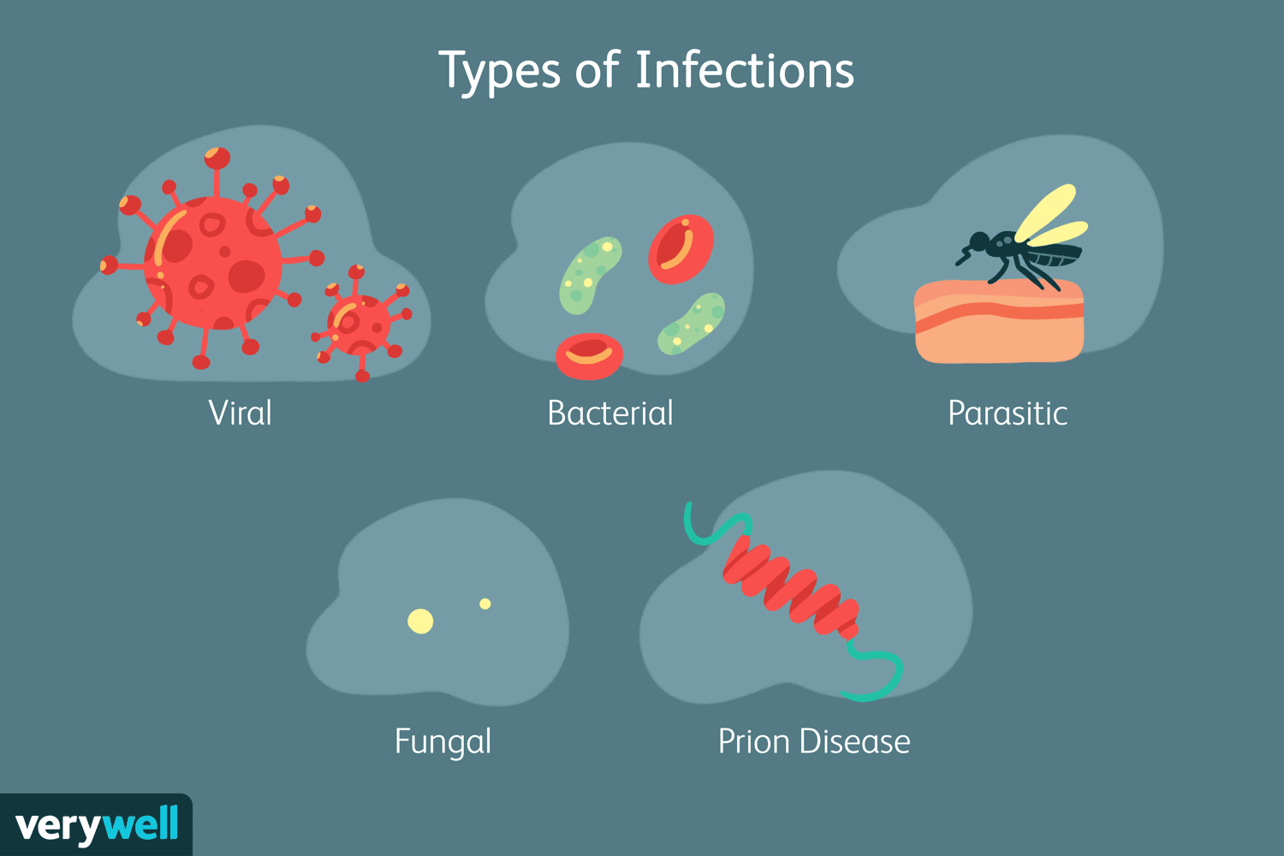
Prevention and Control of Infectious Diseases: Types of Infections
Notes:
Talking Points/Facilitation Notes
Introduce this slide by sharing with providers that you are going to cover some basics about the five main types of diseases that can be spread from person to person
Read the types from the slide:
Viral infections are caused by viruses and include chicken pox, measles, mumps, rubella, and hepatitis
Remind providers that these types of infections do not respond to antibiotics
Bacterial infections are caused by bacteria and include ear infections, strep throat, and urinary tract infections
Share that bacterial infections are treated by antibiotics
Parasitic infections are caused by parasites and include lice, pinworms, and tapeworms
Fungal infections are caused by a fungus and include ringworm, athlete’s foot, or scalp ringworm
Prion Disease is a very rare but fatal brain disease that impacts animals and humans and includes Mad Cow Disease
Explain to providers that these types of infections are commonly spread in five ways and ask for volunteers to share out ideas on how they are spread
Answers Should Include
*Read out any answers not listed by the group
Contact with an infected person
Contact with a contaminated surface
Through the air
Bites from insects
Bites from animals
Sources
https://www.niaid.nih.gov/diseases-conditions/prion-diseases
https://www.verywellhealth.com/infection-5096014
Review the graphic on the slide:

Slide 49
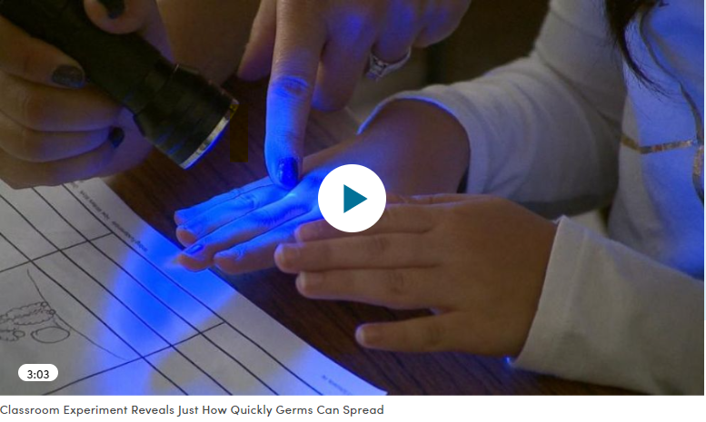
Prevention and Control of Infectious Diseases: The Spread of Germs
Notes:
Talking Points/Facilitation Notes
*THIS IS THE ONLY VIDEO THAT NEEDS TO BE PLAYED IN A BROWSER*
Introduce the video (demonstrates how quickly germs can spread, especially among children)
Play the video online in your browser
Ask for volunteers to share what stood out to them from the video
Video Link
https://www.goodmorningamerica.com/news/video/classroom-experiment-reveals-quickly-germs-spread-26755003

Slide 50
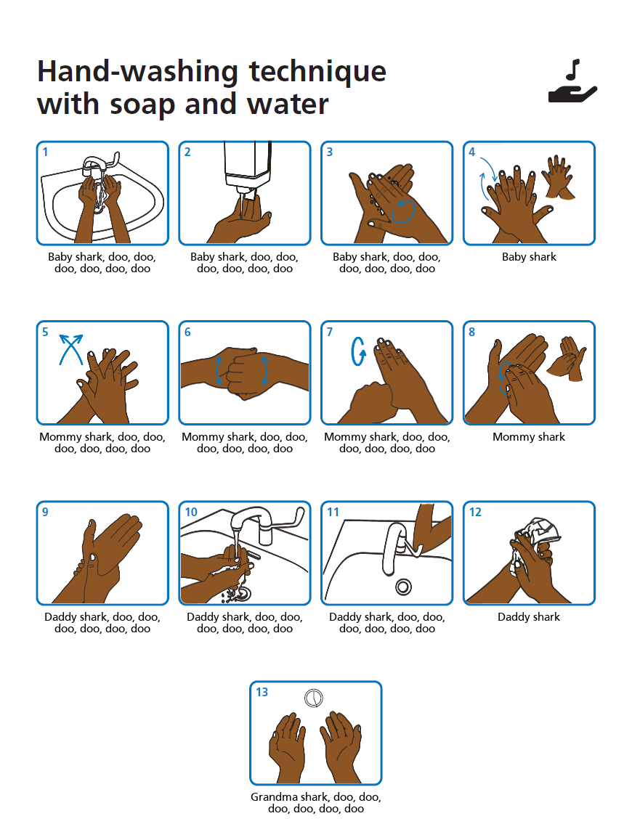
Prevention and Control of Infectious Diseases
Research shows that cell phones carry 10 times more bacteria than most toilet seats
The sink drain is the dirtiest place in the home, followed by the kitchen sponge
Regular handwashing is one of the best ways to remove germs, avoid getting sick, and prevent the spread of germs to others
Notes:
Talking Points/Facilitation Notes
Introduce the slide and explain that germs and bacteria collect in places we might not expect
Review the points on the slide:
Research shows that cell phones carry 10 times more bacteria than most toilet seats
The sink drain is the dirtiest place in the home, followed by the kitchen sponge
Regular handwashing is one of the best ways to remove germs, avoid getting sick, and prevent the spread of germs to others
Explain that how we wash our hands determines whether doing it will be effective at preventing the spread of germs
Ask providers to share what they know about the steps for proper handwashing
Answers Should Include
**Read out any answers not listed by the group
Wet your hands with clean, running water (warm or cold), turn off the tap, and apply soap
Lather your hands by rubbing them together with the soap, lather the backs of your hands, between your fingers, and under your nails
Scrub your hands for at least 20 seconds: hum the “Happy Birthday” song from beginning to end twice
Rinse your hands well under clean, running water
Dry your hands using a clean towel or air dry them
Advance the slide to show the Wash Your Lyrics poster and explain the website
(You can type in your favorite song lyrics and create a handwashing poster that shows which part of the handwashing process you do at which part of the song )
Explain that providers and children (over the age of 2) should use hand sanitizer (at least 60% alcohol content) when there is not a sink with soap and water available but should wash as soon as a sink is available
Ask providers to share what times they think handwashing would be appropriate
Answers Should Include
**Read out any answers not listed by the group
Providing Care
Before and After diapering/toileting (self and children)
Before and After eating, preparing or handling food, and feeding children
Before giving medication
Before and After applying ointment or cream
After touching any bodily fluids
Wiping a runny nose
Brushing teeth
Nose bleeds
After playing outdoors
After playing in water (if used by more than one person)
Household
Before unloading clean dishes
After loading dirty dishes
After cleaning
After handling garbage
After handling animals and/or cleaning up animal waste
Sources
http://www.cdc.gov/handwashing/ (importance of handwashing)
https://www.acf.hhs.gov/sites/default/files/ecd/caring_for_our_children_basics.pdf (when to wash hands)
https://www.cdc.gov/handwashing/when-how-handwashing.html (when and how to wash hands)
https://www.poison.org/articles/2007-jun/hand-sanitizer-whats-the-real-story (hand sanitizer)
https://www.nature.com/articles/s41522-018-0050-9 (sink drain)
https://time.com/4908654/cell-phone-bacteria/ (cell phone)
www.washyourlyrics.com

Slide 51
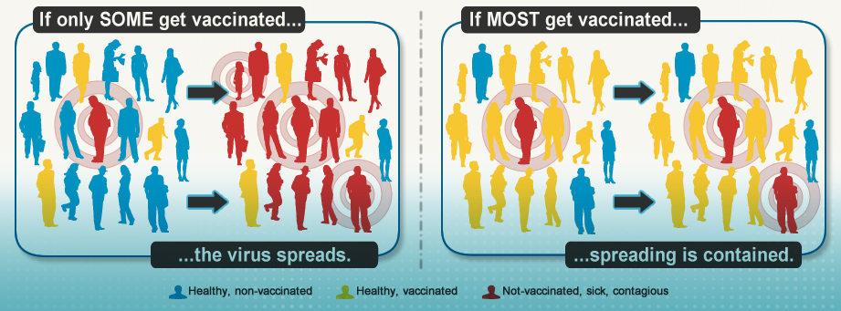
Prevention and Control of Infectious Diseases: The Spread of Germs
This Photo by Unknown Author is licensed under CC BY-NC-ND
Notes:
Talking Points/Facilitation Notes
Introduce the last slide in this section by explaining that vaccinations are another way to prevent the spread of some diseases
Share that, because of vaccines, many diseases that used to cause high rates of death are now preventable
Share that young children are more vulnerable to diseases because their immune system (the body’s natural defense system) isn’t built up yet
Reference the graphic on the slide
Explain that most vaccine preventable diseases are passed person to person, so vaccinated people are less likely to spread diseases
On the other hand, in an environment where there are fewer vaccinated people the virus spreads more easily
Remind providers that vaccination is always the family’s choice
Explain the importance of knowing if children are immunized so that they can communicate vaccination status if the child needs medical attention
Ask providers what questions they might still have about the prevention and control of infectious diseases
Sources
https://childcareta.acf.hhs.gov/sites/default/files/public/infectious_disease_health_safety_brief.pdf (statistic about preschool children)
Module 2 of the required health and safety training for licensed providers
https://www.cdc.gov/vaccines/vac-gen/vaxwithme.html

Slide 52
Administration of Medication
Notes:
Talking Points/Facilitation Notes
Introduce Administration of Medication Consistent with Standards for Parental Consent

Slide 53
Administration of Medication
Providers are required to have written permission to administer prescription medication to each child in care
Discuss the dosing schedule with the family and follow the manufacturer’s directions or the prescription label for any medications
All medications must be stored in their original container
Wash hands before administering medication
Do not call medication candy: explain what the medication is and why the child is taking it
Tell children to only take medication with a trusted adult
Notes:
Talking Points/Facilitation Notes
Introduce this slide by asking providers to raise their hands (or appropriate signal) if they’ve ever had to give medication to a child
Explain that there are some important requirements to keep in mind as a License Exempt Provider
Review the points on the slide:
Providers are required to have written permission from the parent to administer prescription medication to each child in care
Share that LARA provides a Medication Administration Form that you can use to collect permission and track the time and doses given
Explain that this form clearly documents that the parent gave permission for medication to be given to the children
Stress how this can be important in the rare event that a child has a serious reaction to a medication
Explain that if they choose not to use the CDC form, providers must still have written documentation giving them permission from the parent
Remind providers to discuss the dosing schedule with the family and follow the manufacturer’s directions or the prescription label for any medications
Remind providers that all medications must be stored in their original container and that best practice is to wash their hands before administering medication
Stress that providers should never tell children that medication is candy because it makes it more likely that they will take it or try to take it without an adult
Encourage providers to explain what the medication is, why children are taking it and that they should only take medication from a parent or another trusted adult
Sources
Guide to Your Child’s Medicine Video: https://vimeo.com/42781420 stop the video at 1:42
https://www.upandaway.org/#put-meds-away
https://www.healthychildren.org/English/safety-prevention/at-home/medication-safety/Pages/Medication-Safety-Video.aspx
3 American Academy of Pediatrics. (2015). Medication Safety [Video]. Retrieved from https://www.healthychildren.org/English/safetyprevention/at-home/medication-safety/Pages/Medication-Safety-Video.aspx 4 Schillie, S. F., Shehab, N., Thomas, K. E., & Budnitz D. S. (2009). Medication overdoses leading to emergency department visits among children. American Journal of Preventive Medicine, 37(3):181–7. Cited in Centers for Disease Control and Prevention. (2012). The PROTECT Initiative: Advancing Children’s Medication Safety [Web page]. Retrieved from http://www.cdc.gov/MedicationSafety/protect/protect_Initiative.html
https://childcareta.acf.hhs.gov/sites/default/files/public/brief_2_administering_medication_final.pdf

Slide 54
Administration of Medication
ROUTE | DESCRIPTION | EXAMPLES
Oral | These are taken by mouth, either as pills, tablets, capsules, or liquid. They are the most common type. | Cough medicine, Tylenol, Prescription medications, Antibiotics
Topical | Creams, ointments, and drops that are either rubbed on the skin or inserted into openings of the body | Sunscreen, diaper rash cream, eye drops, steroid or antibiotic cream
Inhalants | Sprays you spray into your nose or throat, or nebulizers you breathe through your mouth | Asthma inhalants, nasal sprays for respiratory infections
Injectable | Given in shot form to be injected into the muscle, either in a syringe or an automatic preloaded cartridge | Insulin for diabetes Most common- EpiPen-Automatic Epinephrine
Notes:
Talking Points/Facilitation Notes
Introduce this slide by explaining that standards for medication administration apply to non-prescription medications as well
Remind providers that just because a medication is not prescription does not mean it does not pose a risk to children
Share that best practice is to receive written permission from the parent to administer both prescription and non-prescription medications
(they may use the same medication administration form provided by LARA)
Explain that non-prescription medications are any over-the-counter medications that may be orally ingested, applied to the skin, and some inhalants.
Review the examples on the slide to point out that non-prescription medications include things like cold/flu medications, powders, sunscreen, diaper rash products, bug spray, saline nasal sprays, and pain or fever reducing medications.
These are the medications you may be asked to administer to children under your care.

Slide 55
Administration of Medication:
The Five Rights
The Five Rights
Right Child
Right Medication
Right Dose
Right Way
Right Time
Check the Five Rights
When medication is taken out of storage
Immediately before administering
After administering
Notes:
Talking Points/Facilitation Notes
Introduce the slide by sharing that it shows a list of practices to minimize the chance of making an error when administering medication
Explain that providers will have the chance to practice these skills
Review the points on the slide
The Right Child: Be sure the child listed on the medication form is the child you are giving the medication to
The Right Medication: Check the name of the medication on the form and the name of the medication on the label of the bottle to be sure they are the same
The Right Dose: Compare the dose on the label with the amount you have prepared in the application device and be sure to pay particular attention to whether the medication dose is listed in milliliters (ML) or milligrams (MG) and note which is identified on the administering tool (sometimes a conversion is required on your part)
The Right Way: Check the label to be sure you are giving the medication the same route that it is ordered
The Right Time: Check the form and medication label to ensure you are giving the medication at the proper time
These should be checked at 3 stages of the process- when medication is taken out of storage, immediately before administering, and after administering
Stress that the 5 Rights – Right Child, Right Medication, Right Dose, Right Way, and Right Time – apply to both prescription and over-the-counter medications
Remind providers that over-the-counter medications should be dosed using the child’s weight, not age
Ask providers what questions they might still have about medication administration
Sources
https://www.upandaway.org/#put-meds-away
https://www.healthychildren.org/English/safety-prevention/at-home/medication-safety/Pages/Medication-Safety-Video.aspx
3 American Academy of Pediatrics. (2015). Medication Safety [Video]. Retrieved from https://www.healthychildren.org/English/safetyprevention/at-home/medication-safety/Pages/Medication-Safety-Video.aspx 4 Schillie, S. F., Shehab, N., Thomas, K. E., & Budnitz D. S. (2009). Medication overdoses leading to emergency department visits among children. American Journal of Preventive Medicine, 37(3):181–7. Cited in Centers for Disease Control and Prevention. (2012). The PROTECT Initiative: Advancing Children’s Medication Safety [Web page]. Retrieved from http://www.cdc.gov/MedicationSafety/protect/protect_Initiative.html
https://childcareta.acf.hhs.gov/sites/default/files/public/brief_2_administering_medication_final.pdf

Slide 56
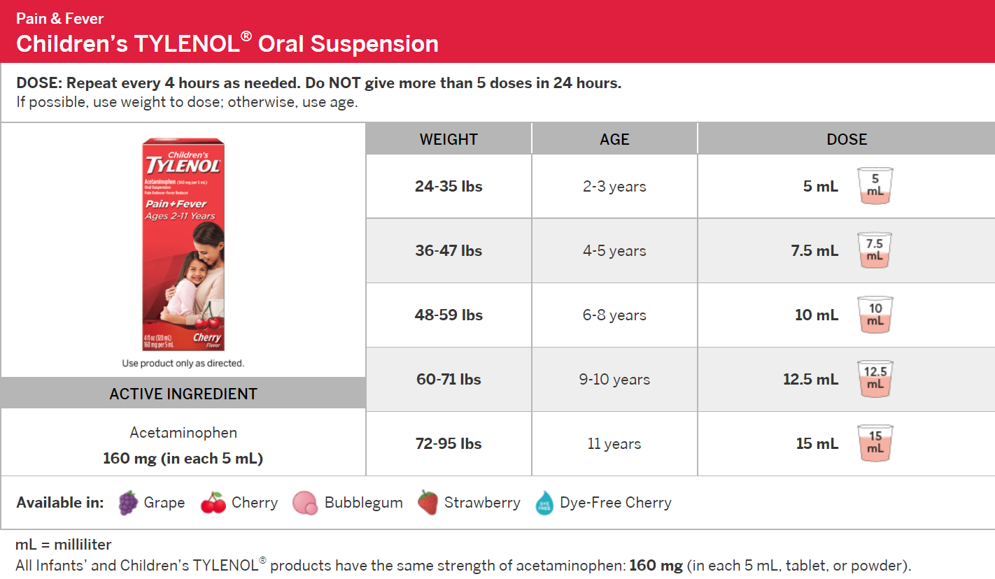
Administration of Medication
Activity
You provide care for Libby, a 3-year-old who weighs 40 pounds. Libby feels warm, so you take her temperature and see that she has a fever. You have written permission from the parent for Libby to have some Tylenol as needed.
How much Tylenol would you give Libby?
Notes:
Talking Points/Facilitation Notes
Introduce this slide by explaining that providers will have the opportunity to practice the skills they learned
Facilitate Medication Administration Activity (ONLY ONE SCENARIO SLIDE IS REQUIRED)
TIME LIMIT: 2-3 minutes per scenario/7 minutes total (any group size)
Activity Goal
To give providers an opportunity to apply the “5 Rights” to medication administration
Right Child
Right Medication
Right Dose
Right Way
Right Time
Review the scenario on the slide:
You provide care for Libby, a 3-year-old who weighs 40 pounds. Libby feels warm, so you take her temperature and see that she has a fever. You have written permission from the parent for Libby to have some Tylenol to help bring her fever down. How much Tylenol would you give Libby?
Advance the slide to show arrow prompts for the 5 Rights and have providers verbally talk through their process of checking the 5 rights at the appropriate times (when medication is taken out of storage, immediately before administering, and after administering)
Sources
https://www.upandaway.org/#put-meds-away
https://www.healthychildren.org/English/safety-prevention/at-home/medication-safety/Pages/Medication-Safety-Video.aspx
3 American Academy of Pediatrics. (2015). Medication Safety [Video]. Retrieved from https://www.healthychildren.org/English/safetyprevention/at-home/medication-safety/Pages/Medication-Safety-Video.aspx 4 Schillie, S. F., Shehab, N., Thomas, K. E., & Budnitz D. S. (2009). Medication overdoses leading to emergency department visits among children. American Journal of Preventive Medicine, 37(3):181–7. Cited in Centers for Disease Control and Prevention. (2012). The PROTECT Initiative: Advancing Children’s Medication Safety [Web page]. Retrieved from http://www.cdc.gov/MedicationSafety/protect/protect_Initiative.html
https://childcareta.acf.hhs.gov/sites/default/files/public/brief_2_administering_medication_final.pdf

Slide 57
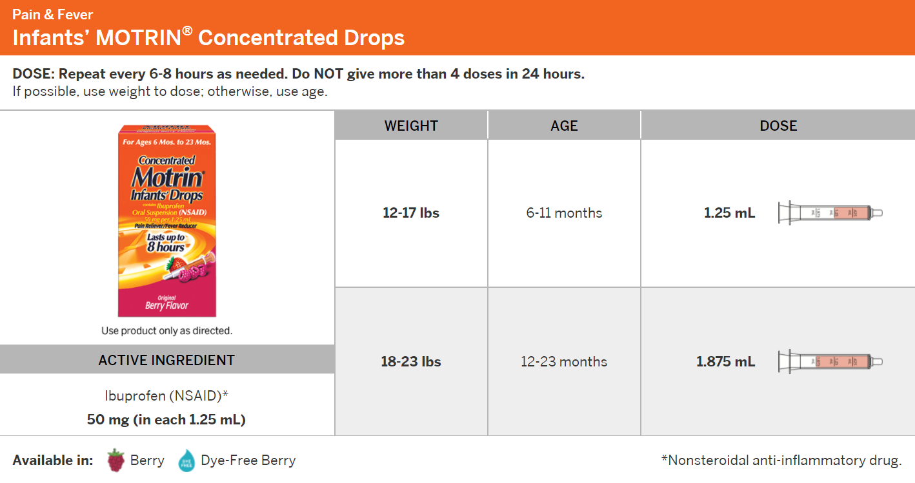
Administration of Medication
Activity
You provide care for Jaylen, a 13-month-old who weighs 17 pounds. Jaylen had his vaccinations this morning and seems uncomfortable. You have written permission from the parent to give Jaylen some Motrin to help relieve any pain he might be experiencing.
How much Motrin would you give Jaylen?
Notes:
Talking Points/Facilitation Notes
Facilitate Medication Administration Activity (ONLY ONE SCENARIO SLIDE IS REQUIRED)
TIME LIMIT: 2-3 minutes per scenario/7 minutes total (any group size)
Activity Goal
To give providers an opportunity to apply the “5 Rights” to medication administration
Right Child
Right Medication
Right Dose
Right Way
Right Time
Review the scenario on the slide:
You provide care for Jaylen, a 13-month-old who weighs 17 pounds. Jaylen had his vaccinations this morning and seems uncomfortable. You have written permission from the parent to give Jaylen some Motrin to help relieve any pain he might be experiencing. How much Motrin would you give Jaylen?
Advance the slide to show arrow prompts for the 5 Rights and have providers verbally talk through their process of checking the 5 rights at the appropriate times (when medication is taken out of storage, immediately before administering, and after administering)
Remind providers of the importance of having written permission prior to any situations like this
Discuss and answer any questions about the scenarios and medication administration
Sources
https://www.upandaway.org/#put-meds-away
https://www.healthychildren.org/English/safety-prevention/at-home/medication-safety/Pages/Medication-Safety-Video.aspx
3 American Academy of Pediatrics. (2015). Medication Safety [Video]. Retrieved from https://www.healthychildren.org/English/safetyprevention/at-home/medication-safety/Pages/Medication-Safety-Video.aspx 4 Schillie, S. F., Shehab, N., Thomas, K. E., & Budnitz D. S. (2009). Medication overdoses leading to emergency department visits among children. American Journal of Preventive Medicine, 37(3):181–7. Cited in Centers for Disease Control and Prevention. (2012). The PROTECT Initiative: Advancing Children’s Medication Safety [Web page]. Retrieved from http://www.cdc.gov/MedicationSafety/protect/protect_Initiative.html
https://childcareta.acf.hhs.gov/sites/default/files/public/brief_2_administering_medication_final.pdf

Slide 58
Handling and Storage of Hazardous Materials and the Appropriate Disposal of Bio-Contaminants
Notes:
Talking Points/Facilitation Notes
Introduce Handling and Storage of Hazardous Materials and the Appropriate Disposal of Bio-Contaminants

Slide 59
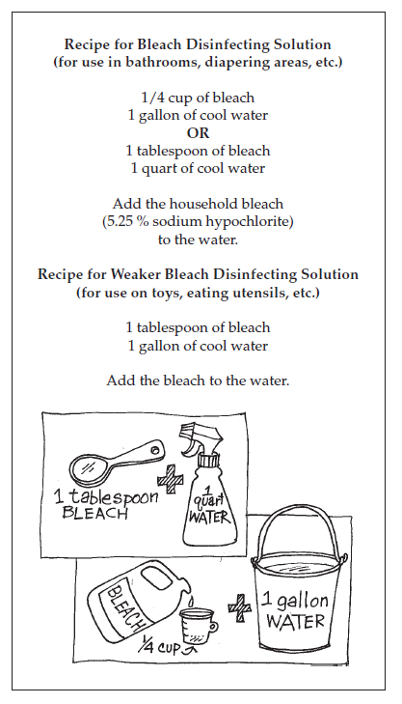
Staying Healthy: Preventing the Spread of Illness and Appropriate Disposal of Bio-Contaminants
Clean up spills immediately
Wear gloves if possible
Prevent spills from coming into contact with eyes, nose, mouth, or open sores
Notes:
Talking Points/Facilitation Notes
Introduce this slide by explaining that when caring for children, contact with bodily fluids (bio-contaminants) is common
Share with providers that understanding how to respond to and clean up bio-contaminants is important because many types of infectious germs may be contained in human waste (urine, feces) and body fluids (saliva, nasal discharge, tissue and injury discharges, eye discharges, blood, and vomit)
Review points on the slide:
Clean up spills immediately
Wear gloves if possible but always be careful to prevent any spills from coming into contact with your eyes, nose, mouth or open sores
Advance the slide to show the disinfecting solution graphic
Explain that the recipe on the screen is for a simple disinfecting solution made with bleach and water
Share with providers that it’s from a guide to sanitizing and disinfecting that covers how to clean up different messes, including bodily fluids, and that they can find the guide in their resource packet
Explain the importance of understanding the difference between clean and disinfected
Clean is how something looks, while disinfected is about using a solution on a surface to kill bacteria and viruses
Remind providers of the importance of carefully reading labels to understand what the cleaner can disinfect, especially natural cleaners, and to ensure they never use cleaners meant for surfaces on human skin
Sources
Schedule for Cleaning, Sanitizing, and Disinfecting | ECLKC
https://www.verywellhealth.com/infection-5096014
https://www.epa.gov/coronavirus/whats-difference-between-products-disinfect-sanitize-and-clean-surfaces
https://childcareta.acf.hhs.gov/sites/default/files/public/7_343_2007_hazardousmaterials_brief_7_final_508compliant.pdf

Slide 60
Handling and Storage of Hazardous Materials: Poisoning
Children are much more vulnerable to hazardous materials exposure than adults
Store items in their original containers and clearly label any homemade cleaners
Always keep toxic items out of sight and reach of children
Notes:
Talking Points/Facilitation Notes
Introduce this slide by explaining that hazardous materials pose a serious risk to the health and safety of children
Review the points on the slide:
Explain that children are much more vulnerable to exposures of hazardous materials than adults because their bodies are developing
Share with providers that because children eat, drink, and breathe more in proportion to their body size and engage in behaviors like crawling and hand to mouth activity, they are naturally at a higher risk for potential poisoning
Explain the importance of recognizing that many products that are safe for adults and older children aren’t safe for smaller children
Ask providers what three items they think might be most commonly involved children’s poison exposures
Answers Should Include
**Read out any answers not listed by the group
Cosmetics/personal care products (anything that’s rubbed into or sprinkled onto the skin – lotions, essential oils, makeup, perfumes, etc.)
Cleaning substances
Medications
Explain that the best way to protect children from exposure is to
Store items in their original containers and label any homemade cleaners clearly and
Always keep toxic items out of reach and sight of children
(stress the importance of thinking about all areas of care like kitchens, bathrooms, basements, garages, etc.)
Ask providers to think about the home where they provide care and share out some ways that they could store hazardous items out of reach and sight
Sources
https://upandaway.org/wp-content/uploads/2015/04/UpAndAway_Brochure.pdf
https://upandaway.org/resource/up-and-away-poster/
https://childcareta.acf.hhs.gov/sites/default/files/public/7_343_2007_hazardousmaterials_brief_7_final_508compliant.pdf
https://today.wayne.edu/medicine/news/2021/03/20/michigan-residents-encouraged-to-take-precautions-during-national-poison-prevention-week-41957

Slide 61
Handling and Storage of Hazardous Materials: Medication
Purses
Bathroom Cabinet
Bedside Tables
Pill Box on Countertop
Notes:
Talking Points/Facilitation Notes
Introduce this slide by explaining that the pictures on the screen show common places that people store medications
Ask providers to share out which of these locations they believe is a safe place to store medications
Answer is NONE
Explain that even though the bathroom cabinet is a common place to store medications, the most recent recommendations from Poison Control indicate it’s no longer safe
Share that the change in the temperature and humidity in the bathroom can impact the effectiveness of medication, and in many cases the medications are easily accessible to older children
Remind providers that all medications and toxic items should always be kept out of sight and reach
Ask providers to share out ideas for what might be the safest place to store medications in the home where they’re providing care
Sources
https://www.upandaway.org/#put-meds-away
https://www.healthychildren.org/English/safety-prevention/at-home/medication-safety/Pages/Medication-Safety-Video.aspx
3 American Academy of Pediatrics. (2015). Medication Safety [Video]. Retrieved from https://www.healthychildren.org/English/safetyprevention/at-home/medication-safety/Pages/Medication-Safety-Video.aspx 4 Schillie, S. F., Shehab, N., Thomas, K. E., & Budnitz D. S. (2009). Medication overdoses leading to emergency department visits among children. American Journal of Preventive Medicine, 37(3):181–7. Cited in Centers for Disease Control and Prevention. (2012). The PROTECT Initiative: Advancing Children’s Medication Safety [Web page]. Retrieved from http://www.cdc.gov/MedicationSafety/protect/protect_Initiative.html
https://childcareta.acf.hhs.gov/sites/default/files/public/brief_2_administering_medication_final.pdf
https://www.poison.med.wayne.edu/updates-content/ae9cbud25a3v7kbxyb28c4sfpumsb5

Slide 62
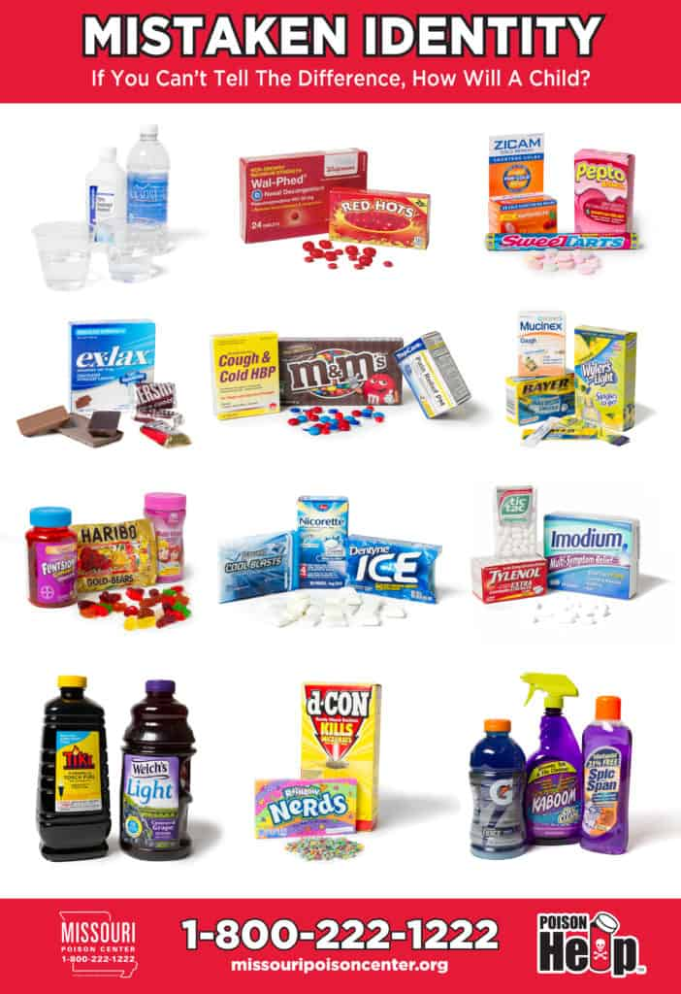
Handling and Storage of Hazardous Materials: Mistaken Identity Items
Notes:
Talking Points/Facilitation Notes
Review the graphic on the slide by explaining that many harmful substances look like items that can be drunk or eaten
Stress that many children will not be able to tell the difference
Facilitate Mistaken Identity Activity
TIME LIMIT: 5-7 minutes (any group size)
Activity Goals
To introduce providers to common mistaken identity items
To demonstrate how similar hazardous substances and food/drink items can be
Introduce the activity by sharing that providers will now have the opportunity to try identifying items that are safe to eat or drink
Stress that this is a silent activity – there will be time to share out after the final slide
IN PERSON
Explain that providers will choose which item (#1 or #2) on the slide is SAFE to consume and move to that side of the room
VIRTUALLY
Explain that providers will hold up 1 or 2 fingers on each hand to indicate their choice (demonstrate the given options)
Advance to each slide with one click to show two different substances, click a second time to reveal which is safe
Sources
Upandaway.org
https://childcareta.acf.hhs.gov/sites/default/files/public/7_343_2007_hazardousmaterials_brief_7_final_508compliant.pdf

Slide 63
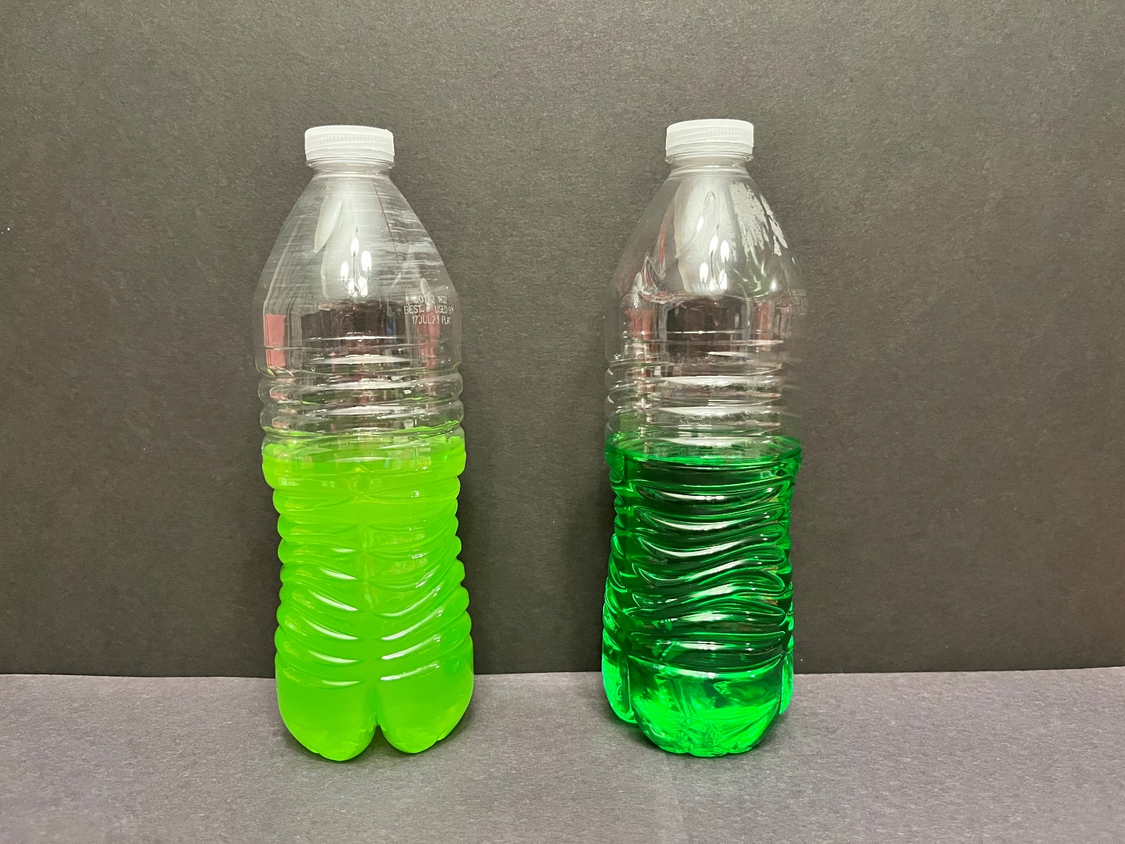
Handling and Storage of Hazardous Materials: Mistaken Identity Items
Activity
1
2
Juice
Fabuloso
Notes:
Talking Points/Facilitation Notes
Introduce the slide by sharing that one of these substances is juice
Ask providers to silently choose which container holds juice and move to that side of the room (#1 to the left side of the room, #2 to the right side of the room)
Click once to reveal which item is which

Slide 64
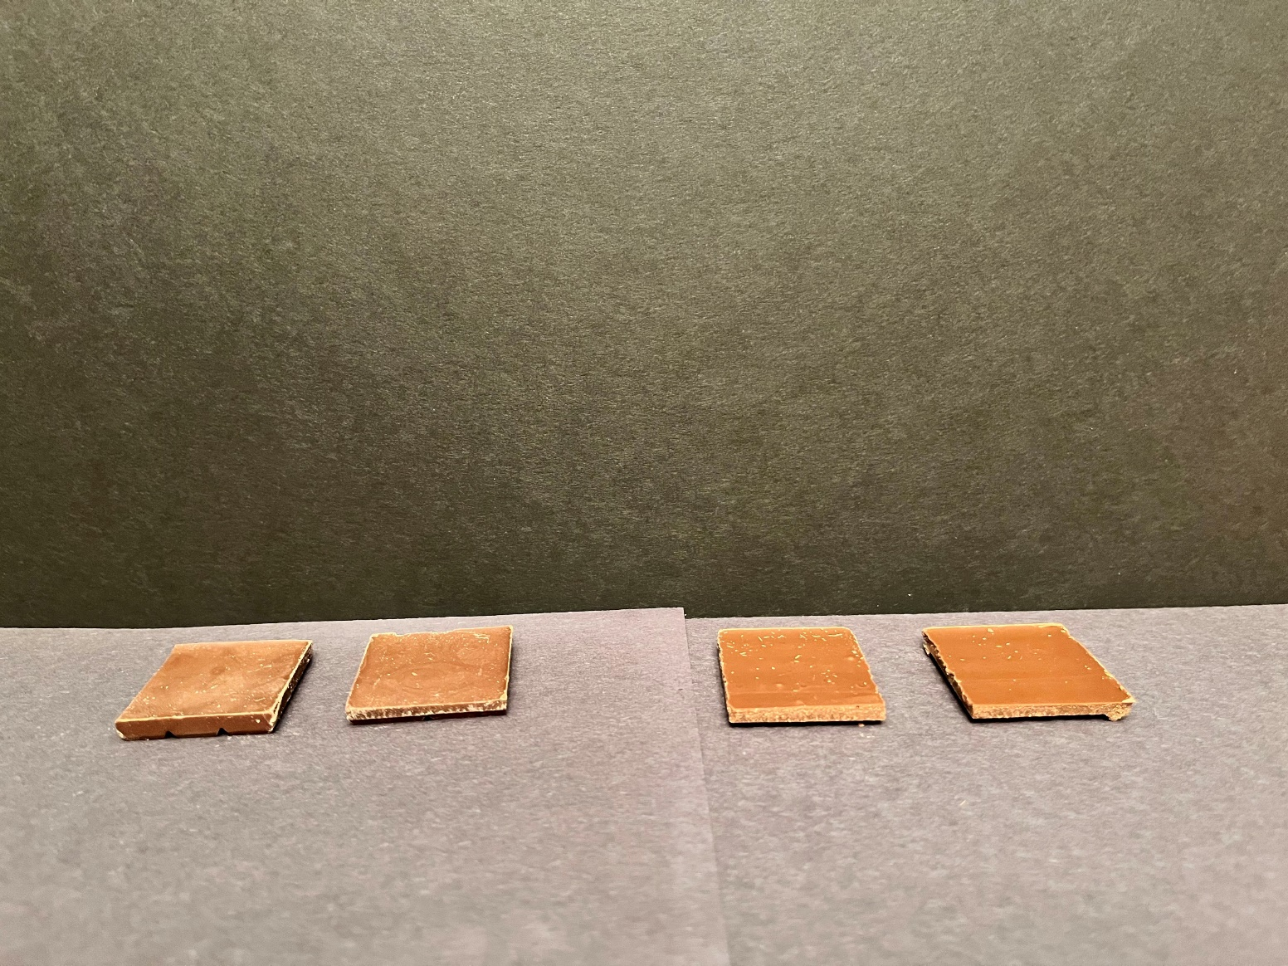
Handling and Storage of Hazardous Materials: Mistaken Identity Items
Activity
1
2
Ex Lax
Chocolate
Notes:
Talking Points/Facilitation Notes
Introduce the slide by sharing that one of these substances is chocolate
Ask providers to silently choose which set is chocolate and move to that side of the room (#1 to the left side of the room, #2 to the right side of the room)
Click once to reveal which item is which

Slide 65
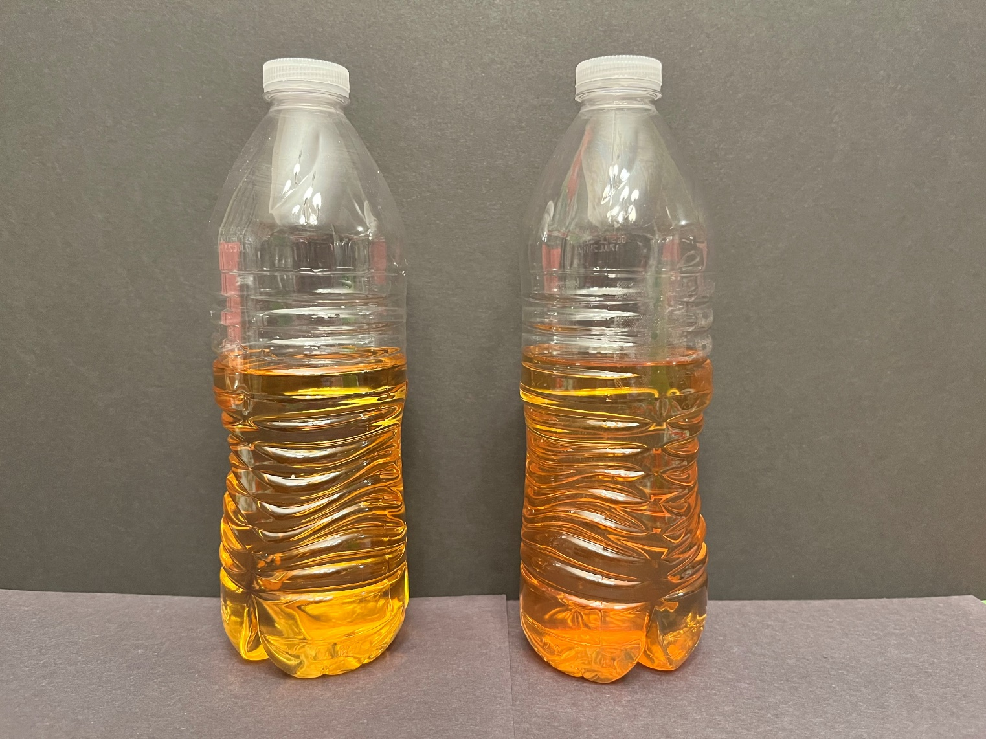
Handling and Storage of Hazardous Materials: Mistaken Identity Items
Activity
1
2
Apple Juice
Pine Sol
Notes:
Talking Points/Facilitation Notes
Introduce the slide by sharing that one of these substances is apple juice
Ask providers to silently choose which container holds apple juice and move to that side of the room
(#1 to the left side of the room, #2 to the right side of the room)
Click once to reveal which item is which
Ask providers to silently choose which set is chocolate and move to that side of the room (#1 to the left side of the room, #2 to the right side of the room)
Click once to reveal which item is which

Slide 66
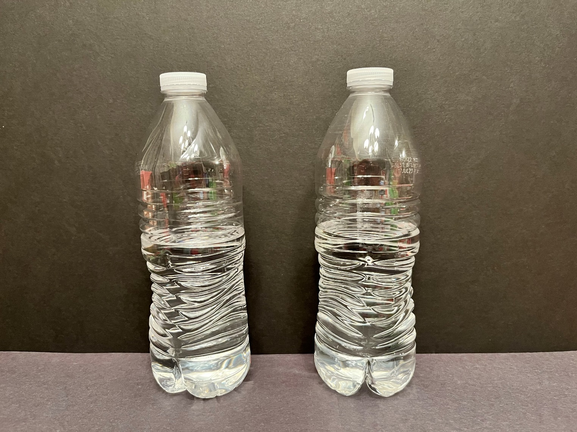
Handling and Storage of Hazardous Materials: Mistaken Identity Items
Activity
1
2
Rubbing Alcohol
Water
Notes:
Talking Points/Facilitation Notes
Introduce the slide by sharing that one of these substances is water
Ask providers to silently choose which container holds water and move to that side of the room (#1 to the left side of the room, #2 to the right side of the room)
Click once to reveal which item is which
Once everyone has transitioned back, ask for volunteers to share what surprised them the most during the activity
Ask for volunteers to share what item(s) they found most difficult to identify
Ask providers to share one thing they will change after experiencing this activity

Slide 67




Handling and Storage of Hazardous Materials: Poison Control
If you think a child may have been poisoned call Poison Control: 1-800-222-1222
        Important Information:
            Child’s Weight
            Child’s Height
            What they ate or touched
            How much was consumed
            Where it touched their body
            When it was consumed or touched
Notes:
Talking Points/Facilitation Notes
Introduce this slide by sharing that accidental poisoning is the leading cause of injury and death among young children
Review the points on the slide:
Explain that it’s important to call Poison Control if you ever suspect that a child has put something toxic in or on their body
Poison Control is a 24-hour, 365 day a year toll-free phone number that you can call to speak to a trained expert
Provide the number to Poison Control (1-800-222-1222) and prompt providers to save it in their phones and remind them to post it in the home(s) where they provide care
Explain that there is certain information that Poison Control will need to know:
Child’s Weight
Child’s Height
What they ate or touched
How much was consumed
Where it touched their body
When it was consumed or touched
Source
https://today.wayne.edu/medicine/news/2021/03/20/michigan-residents-encouraged-to-take-precautions-during-national-poison-prevention-week-41957

Slide 68
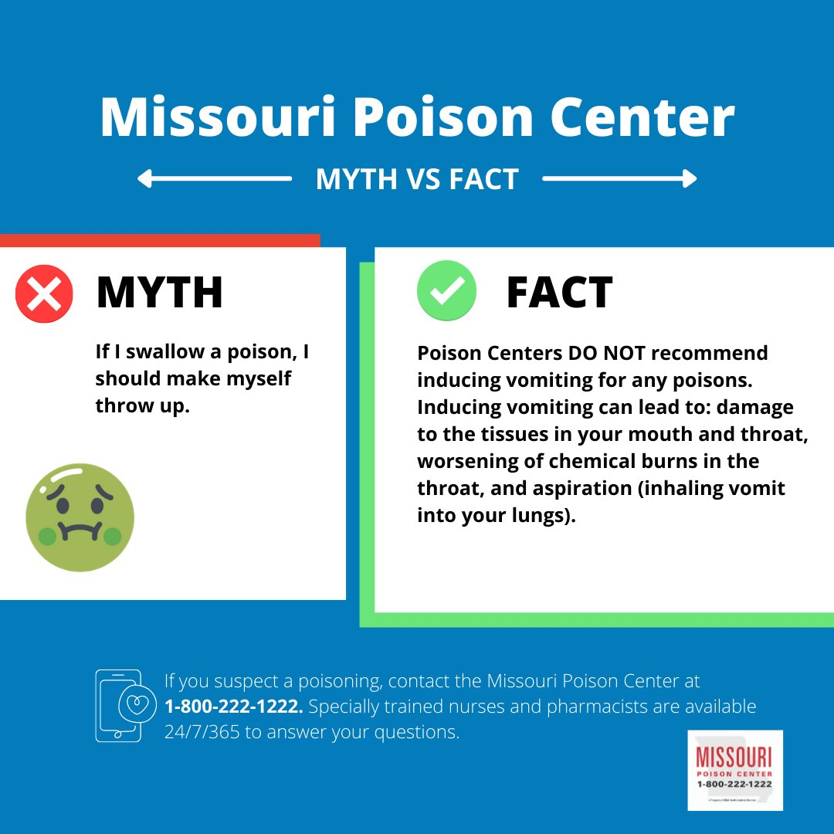
Handling and Storage of Hazardous Materials: Myth or Fact?
Myth or Fact?
If a child has been poisoned, you should make them throw up.
Notes:
Talking Points/Facilitation Notes
Introduce the last slide in this section by asking providers: Myth or Fact? If a child has been poisoned, you should make them throw up
Have providers give two thumbs up (FACT) or cross their arms in an “X” (MYTH)
Advance the slide
Explain that providers should never induce vomiting, unless Poison Control directs them to do so, because in many situations it can cause more harm
Stress the importance of only taking action that is directed by Poison Control
Ask providers what questions they might still have about calling Poison Control or hazardous materials

Slide 69
Break
Please return in 5 minutes
Notes:
Talking Points/Facilitation Notes
To use as determined by the trainer

Slide 70
Emergency Preparedness and Response Planning
Notes:
Talking Points/Facilitation Notes
Introduce Emergency Preparedness and Response Planning (for Emergencies Resulting from a Natural Disaster or a Human-Caused Event)
Explain that you’ll review different types of possible emergencies give opportunities for providers to think about how to respond
Encourage them to communicate with and involve the family in all emergency response plans

Slide 71
Emergency Preparedness and Response Planning: Have a Plan!
A plan for:
evacuation
safely moving children to a relocation site
shelter-in-place
lockdown
contacting parents and reuniting families
how infants and toddlers will be accommodated in all types of emergencies
how children with special needs will be accommodated in all types of emergencies
how children with chronic medical conditions will be accommodated in all emergencies
continuing operations during or after a disaster
Training any volunteers on the plan
Practice the plan—conduct fire, tornado and lock down drills; revise the plan if necessary
Notes:
Talking Points/Facilitation Notes
Introduce the topic of needing a plan for all emergency situations when caring for children
Ask for volunteers to share what emergencies there could be
Read the points on the slide of what to have a plan for
Explain that having and practicing a plan is the best way to be prepared.
Let providers know there is a detailed Family Preparedness Guide in the Resource Packet to assist with creating your plan.
Resources to plan
Plan (michigan.gov)
MIREADY (michigan.gov)

Slide 72
Emergency Preparedness and Response Planning: Injury/Illness
Parental consent to seek medical treatment
Preferred place for emergency and non-emergency medical care
Non-emergency transportation arrangements
Care for other children
Notes:
Talking Points/Facilitation Notes
Introduce the topic of response to injury by explaining that sometimes children get hurt or get sick and need medical attention
Explain that there are endless possible situations in which a child might be injured and ask for volunteers to share what they could be
(car accident, falling off playground equipment, etc.)
Explain that providers should consider the following points for any type of situation where medical care is needed
Review the points on the slide:
Parental consent to seek medical treatment
Written and signed consent is required to allow you to seek medical treatment for the children in your care
Preferred place for emergency and non-emergency medical care
Does the family prefer urgent care, the pediatrician’s office, a local clinic, the hospital (which one), etc.?
Non-emergency transportation arrangements
Will the provider or family take the child to get medical care if it’s not an emergency?
Care for other children
If there are multiple children, who will care for them if the provider needs to leave with a sick or injured child?

Slide 73



Emergency Preparedness and Response Planning: Serious Injury or Death
Report Serious Injury or Death
Within 5 days to CDC
Any physical harm that requires emergency intervention (whether self-inflicted or caused by someone else)
Burns, lacerations, bone fractures, significant blood loss and/or injuries to internal organs
Notes:
Talking Points/Facilitation Notes
Introduce this slide by explaining that, though it’s difficult to think about, a serious injury or death could occur while a child is being cared for
Share with providers that, in that situation, they have a responsibility to take the following action
Review the points on the slide:
Report any serious injury or death of a child in care to CDC within 5 days of it happening using the LEP Serious Injury Report or by calling the CDC 866 number (1-866-990-3227)
Explain that serious injury means: any physical harm to a child that requires emergency safety intervention (whether self-inflicted or by someone else)
Share that this includes, but is not limited to, burns, lacerations, bone fractures, significant blood loss, and injuries to internal organs

Slide 74
Emergency Preparedness and Response Planning: Evacuation
Activity
What kinds of situations could require an emergency evacuation?
It’s your turn!
You’re caring for the children when the doorbell rings. You answer the door, and a local Emergency Responder tells you that there’s been a gas leak in the neighborhood. He tells you that you have 10 minutes to evacuate the home with the children.
What do you do?
Notes:
Talking Points/Facilitation Notes
Introduce this slide by explaining that some situations could require an emergency evacuation of the home and ask providers what kinds of situations they think could require this
Answers Should Include
*Read out any answers not listed by the group
A gas leak
Widespread fire
A flood
A chemical spill
Violence in the community
Advance the slide
Explain that providers will now think through their own evacuation scenario
Encourage them to be thinking specifically about the home where they provide care
Facilitate Emergency Evacuation Activity
TIME LIMIT: 5 minutes (any group size)
Activity Goals
To engage providers in brainstorming how they might respond in an emergency evacuation
Have participants work individually
Ask participants to share out their responses and make sure they have included the following considerations:
Answers Should Include
Meeting place for parent
Transportation (what will the provider do if transportation is not available?)
Critical items needed (if time allows)
Encourage providers to make a formal evacuation plan with the family and remember to:
Follow all directions from authorities
Have a designated location to take the children if the home or area isn’t safe
Have access to the news through radio or tv if possible
Stay in contact with the family
Sources
https://www.oakgov.com/health/services/Documents/Go%20Kit%20Brochure.pdf
https://detroitmi.gov/departments/homeland-security-emergency-management-detroit/emergency-preparedness/emergency-planning

Slide 75
Emergency Preparedness and Response Planning: Lockdown
Lights out
Doors locked and barricaded
Stay out of sight
Wait for first responders
Notes:
Talking Points/Facilitation Notes
Introduce the slide by explain that Lockdown is used in a situation when you need to be secure inside.
Examples of when to lockdown can include:
An intruder or violence in the community.
Ask a volunteer to read the steps for a lockdown on the slide.
The building should be secured with the lights out, and the doors locked with furniture up against them. Stay out of sight from windows or anyone who may pose a harm risk outside. Stay in lockdown until a first responder dismisses them.
In the case of a missing child, you should lockdown, call 911 and the parents.
Lockdown drills should be practiced once a year

Slide 76



Emergency Preparedness and Response Planning: Fire
What was the leading cause of reported fires in Michigan in 2023?
What room did those fires most often start in?
What are some fire hazards in the home?
Notes:
Talking Points/Facilitation Notes
Introduce this slide by stressing that fires can and do happen
In 2023 in Michigan, there were 125 Deaths in 112 Fires
Review the points on the slide:
Ask participants what they think might have been the leading cause of reported fires in Michigan in 2023 (smoking)
Ask participants what room fires in Michigan most often started in (the Bedroom, followed by the living room, followed by the kitchen)
Have participants share out what fire hazards might be present in the home
Answers Should Include
*Read out any answers not listed by the group
Matches, lighters, and candles
Cords can cause fires if wiring is exposed from being stepped on or under rugs or carpets
Surge protectors can cause fires when too many things are plugged in
Barbeque lighters and lighter fluid/starters, instant briquettes (pre-made bricks)
Flammable liquids- nail polish remover, kerosene, gasoline, paint thinner, paints and oils
Space heaters
Cigarettes
Appliances (toaster, microwave, toaster oven)
Flammable items such as towels or piles of clothing piles near anything that gets hot
Having grease from previous meals or other flammable grime on the cooktop
Dryer lint
Sources
Fire Stats (mfis.org)
https://mfis.org/fire-stats

Slide 77
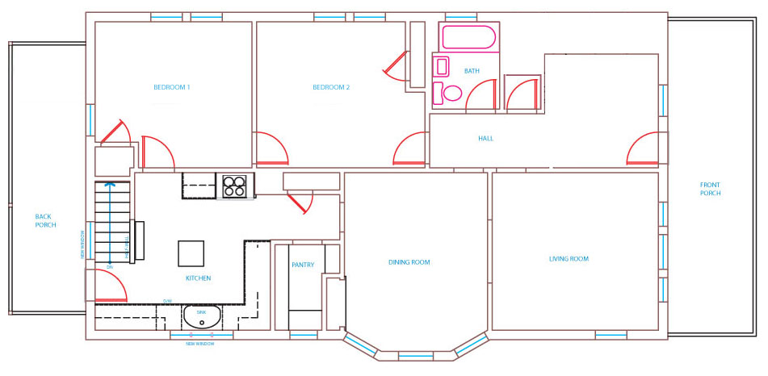
Emergency Preparedness and Response Planning: Fire Plans
Activity
Identify Exits
Identify Hazards
Meeting Place
Plan to Close Doors
Infants, Toddlers, and Special Needs
This Photo by Unknown Author is licensed under CC BY-SA
Notes:
Talking Points/Facilitation Notes
Introduce this slide by asking participants if anyone knows how much time they think they might have to evacuate in the event of a fire (2 minutes or less)
Share that in the past, people had up to 17 minutes to escape, but because of new types of materials, furniture, and construction, fire spreads faster than ever
Explain the importance of having a plan to escape in the event of a fire
Share that participants are going to spend a few minutes creating a fire plan for the home where they provide care (choose one if they provide care at more than one home)
Remind providers to review the plan with the parents and children and make any adjustments together
Encourage providers to consider the following things in making a fire plan (review the points on the slide):
Identify two exits for each room – one will often be a window
Think about and note potential hazards – furniture blocking a door, items in hallways, equipment that might pose a tripping hazard
Choose a meeting place outside that everyone can access – think about how you might mark this location for young children (make a visible mark, tie a ribbon, etc.)
Encourage providers to make closing doors part of their plan (explain that they’ll learn more about that next)
Remind providers to plan specifically for infants and toddlers, and children with chronic health challenges or special needs
(if a child cannot exit on their own, if a child doesn’t respond well to being touched, if a child is bothered by loud noises, if a child has special needs around hearing or sight, etc.)
Have providers follow the instructions on the planning handout (https://www.safekids.org/sites/default/files/documents/fire_escape_plan_grid.pdf)
Facilitate Fire Plan Activity
TIME LIMIT: 10 minutes (any group size)
Activity Goal
To support providers in developing a written fire plan for the home where they provide care
Check in with individuals and be available for questions
Handout
https://www.safekids.org/sites/default/files/documents/fire_escape_plan_grid.pdf
Sources
https://www.michigan.gov/documents/lara/NFPA._Escape_Planning_tips._7.2019._MIPLogo_ECS._Final_663894_7.pdf
https://www.michigan.gov/lara/0,4601,7-154-89334_42271_42384-140662--,00.html smoke detectors
https://www.michigan.gov/documents/lara/DN_Installation_Form_711419_7.pdf (where to place smoke detectors)
https://www.michigan.gov/documents/lara/NFPA._Smoke_alarm_disability_tips._7.2019._MIPLogo._ECS._Final_663829_7.pdf (different types of smoke detectors)

Slide 78
Emergency Preparedness and Response Planning: Practicing Plans
Monthly test
Monthly practice
Practice all exits
What happens at the Meeting Place?
Never go back inside
Notes:
Talking Points/Facilitation Notes
Introduce this slide by explaining that while it’s helpful to make a fire plan, practicing the plan is one of the best ways to prevent death and ensure that everyone gets out as quickly as possible
Review the points on the slide:
Share with providers that it’s important to test the home’s smoke detectors every month and explain that there should be one on every floor (best practice is to have them placed outside the sleeping areas/bedrooms)
Remind providers that there are smoke detectors available for different needs (flashing lights, vibration for a bed, etc.) and that they can reach out to their local fire department if they need smoke detectors
Encourage providers to use the smoke detector test to prompt their fire plan practice with the children so that it’s also happening every 3 months while the weather is appropriate (March-November)
Explain that this helps the plan become a habit
Share that practice should happen at different times and on different days during the week
Remind providers that monthly practice should include all exits and include talking through exiting from windows (review with children how to remove screens or other obstacles in order to climb out if needed (age appropriate))
Share with providers the importance of teaching children what to do at the meeting place – what should they do if they arrive, and you are not there? Should they seek out a neighbor? Call 911?
Explain that children need to know that the best place to be during a fire is out of the house and that once they’re out, to stay out – they should never go back inside
Ask providers what questions might remain about making and practicing fire plans
Sources
https://www.michigan.gov/documents/lara/NFPA._Escape_Planning_tips._7.2019._MIPLogo_ECS._Final_663894_7.pdf
https://www.michigan.gov/lara/0,4601,7-154-89334_42271_42384-140662--,00.html smoke detectors
https://www.michigan.gov/documents/lara/DN_Installation_Form_711419_7.pdf (where to place smoke detectors)
https://www.michigan.gov/documents/lara/NFPA._Smoke_alarm_disability_tips._7.2019._MIPLogo._ECS._Final_663829_7.pdf (different types of smoke detectors)

Slide 79
Emergency Preparedness and Response Planning: Tips for Survival
If you must exit through smoke, get low
Lower children first, by the wrist
Call 911 and tell your exact location
Close the door, block smoke with towels or sheets
Be ready to signal from the window
Keep the window clear of any objects
Notes:
Talking Points/Facilitation Notes
Introduce the last slide on fire prevention by explaining that you’ll share some tips for survival in the event of a fire
Review the points on the slide:
Explain the importance of teaching children to stay as low to the ground as possible if they must exit through an area filled with smoke to prevent inhaling toxic fumes
Ask providers what they might do if they and the children had to evacuate from a window that was on a second story or higher without a fire ladder
Explain that the best way to evacuate this way is getting children out first by holding onto their wrists (not their hands) and lowering them out of the window
Share that this method ensures that when you let go, the children have no choice but to drop
Ask providers what they might do if they and the children become trapped and unable to evacuate the home?
Answers Should Include
**Read out any answers not listed by the group
Call 911 and give them your exact location even if the Fire Department is already on the scene
Close the door to the room/area
Stuff towels or sheets underneath the doorway and vents to block smoke
Use a flashlight, white sheet, or something else to signal from the window
Keep the window clear of mattresses or anything else that could block it and prevent responders from getting to you or keep you from getting out
Remind providers to familiarize themselves with any special fire plan protocols the apartment or Highrise building where they provide care might have (talk to landlord)
Invite participants to raise their hands if they’ve ever been taught that it’s safest for children to sleep with the door open
Share that best practice has changed and we now know it’s safest to have everyone in the home sleep with the door closed
Introduce the to the phrase “Close before you doze” and explain the importance of sleeping with the door closed.
Give the following points:
Toxic gas amounts are lower in rooms with closed doors
Closed doors provide a barrier that allows more time to escape (connect to fire plan)
Ask providers what questions they might still have about fire prevention and preparedness
Sources
https://www.michigan.gov/documents/lara/NFPA._Remebering_when_fire_safety_Tips._7.2019._MIPLogo._ECS._Final_663887_7.pdf (source for high rise info)
https://www.usfa.fema.gov/downloads/pdf/publications/fire_safety_disabilities_flyer.pdf
Video Link
https://www.youtube.com/watch?v=bSP03BE74WA

Slide 80
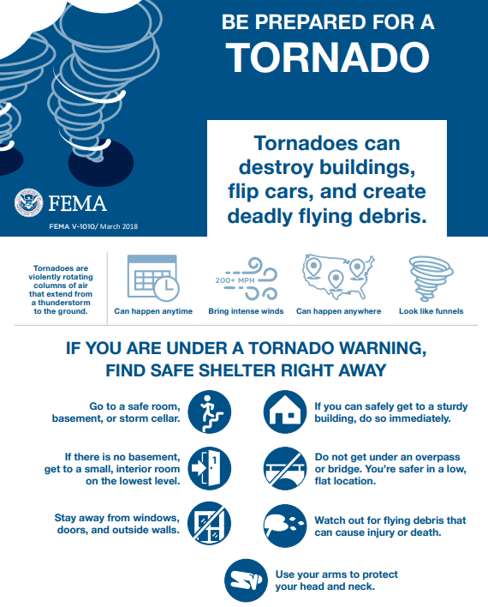
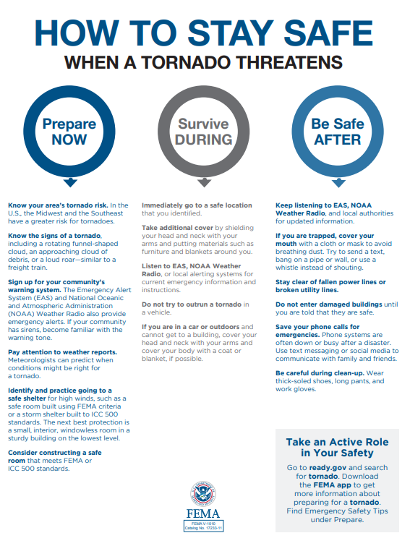
Emergency Preparedness and Response Planning: Tornado
Notes:
Talking Point/Facilitation Notes
Introduce tornado preparedness
Explain the importance of understanding that flying debris is deadly during a tornado
Share that where we are when a tornado occurs will change the way we need to take shelter
Ask for volunteers to share what they know about taking shelter in the event of a tornado
Answers Should Include
**Read out any answers not listed by the group
House/Apartment
Go to the basement or lowest level of the home or apartment complex and avoid windows
Get under sturdy objects like tables or workbenches and cover up with blankets for more protection
Mobile Home
Mobile homes cannot hold up to tornado winds
It is best to find a nearby building you can go to for shelter (school, community center, store, etc.)
Outside
If you cannot get to a sturdy building (store, community center, etc.), find a low-lying area, like a ditch, and cover your head with an object or your arms
Avoid places with trees since they can cause more dangerous debris or fall on top of you
Driving
If a tornado is occurring while you're driving, stop and find a nearby building to take shelter in or seek low-lying ground
Vehicles are not safe against tornado winds
Never stay in or under a vehicle during a tornado and never try to outrun a tornado in your vehicle
Share that part of preparedness is having a kit with snacks, blankets, activities, water, and a radio or weather radio if the family has one
Remind providers the importance of saving their phone battery in any emergency to call for help or to contact the family, rather than using it to check the news for weather updates, etc.
Tornado drills should be practiced twice a year between March and November
Ask providers what they are still wondering about tornado planning
Sources
https://www.michigan.gov/michiganprepares/0,4621,7-232-65025_65035---,00.html
https://weather.com/safety/tornado/news/what-to-do-in-storm-mobile-home-tornado

Slide 81






Emergency Preparedness and Response Planning: Lost Child
Establish rules for outings
For older children, set a meeting place
Dress children brightly
Show children who can help
Tell children what to do if approached
Teach children essential Information
Notes:
Talking Points/Facilitation Notes
Introduce the final slide in this section and explain that you’ll share tips on how to help prevent the situation of a lost child
Remind providers of the power of active supervision (focused attention and intentional observation), considering the ages and developmental abilities of all the children and making plans with the family
Review the points on the slide:
Establish rules for outings
Share that children of all ages need to know what the expectations are
Share some examples:
Stay with an adult, even when going to the bathroom (younger children)
Check-in with an adult before going to a different area (older children)
For older children set a meeting place
Share the importance of establishing a meeting place at locations you visit frequently
This is a place older children should go if they become separated from you
Ask providers to think about the places they frequently take children on outings and suggest some possible meeting places
Examples: information booths, snack stands, lifeguard chairs, the security desk in the mall, Police Station, and Fire Department
Dress children brightly
Consider dressing children in bright colors so you can easily spot them
Consider snapping a quick picture before you leave the home so that authorities can see what the children look like and were wearing that day
Ensure the children’s names are not visible on their clothing or bodies – children are likely to follow someone who is calling their name, even if they’re not a familiar person
Show children who can help
Teach children the houses and families in the neighborhood who are safe to go to if there’s a problem
Teach children to look for a “Mommy” or someone with children
Tell children what to do if approached
Explain that children need to call as much attention to themselves as possible
Teach children to run and scream if someone is following them or tries to force them into a car
Help kids get help
Explain the importance of teaching children their name, address, phone number and parent/guardian’s name, as well as the provider’s name and phone number
Sources
https://kidshealth.org/en/parents/abductions.html
https://www.aus.com/security-resources/lost-child-prevention
https://missingkids.ca/en/how-can-we-help/lost-child/prevention/
https://www.healthychildren.org/English/safety-prevention/all-around/Pages/Preventing-Child-Abductions.aspx

Slide 82
Break
Please return in 5 minutes
Notes:
Talking Points/Facilitation Notes
We’ve arrived at our last break for the training
Please take these five minutes to grab a drink, stretch, grab a snack, and I’ll see you at ____________

Slide 83
Prevention of and Response to Emergencies Due to Food and
Allergic Reaction
Notes:
Talking Points/Facilitation Notes
Introduce Prevention of and Response to Emergencies Due to Food and Allergic Reaction

Slide 84
Prevention of and Response to Emergencies Due to Food and Allergic Reaction: Food Safety
Make sure food prep surfaces are cleaned and disinfected
Wash fresh fruits and veggies before serving them
Breastmilk and formula in bottles should be thrown away after two hours; Any prepared formula must be discarded within one hour after serving to an infant
Transfer baby food out of the jar before feeding
Refrigerate food within two hours after eating and discard any uneaten food left out longer, as well as any unsealed or homemade baby food stored in the fridge for over 24 hours—when in doubt, throw it out
Notes:
Talking Points/Facilitation Notes
Introduce the topic of food safety by explaining that providers can take some action to prevent foodborne illness
Review the points on the slide:
Make sure food preparation surfaces are clean and disinfected (link back to handwashing and the difference between cleaning and disinfecting)
Wash fresh fruits and veggies before serving them
Breastmilk and formula in bottles should be thrown away after two hours; Any prepared formula must be discarded within one hour after serving to an infant
Frozen Breastmilk has specific requirements for thawing and storage
o It should be thawed and stored in the refrigerator overnight or by placing it under warm running water or in a bowl of warm water.
o Never heat frozen breast milk in the microwave or on the stove.
o Don’t refreeze thawed breastmilk. Throw it away if not used within 24 hours of refrigeration
Transfer baby food out of the jar before feeding
Refrigerate food within two hours after eating and discard any uneaten food left out longer, as well as any unsealed or homemade baby food stored in the fridge for over 24 hours—when in doubt, throw it out
Ask providers what questions they might still have about food safety
Source
CFOC Standards Database | National Resource Center
Breast Milk Storage and Preparation | Breastfeeding | CDC
Infant Formula Preparation and Storage | Infant and Toddler Nutrition | CDC
Food Safety | Food Safety | CDC
Caring for Our Children | National Resource Center

Slide 85
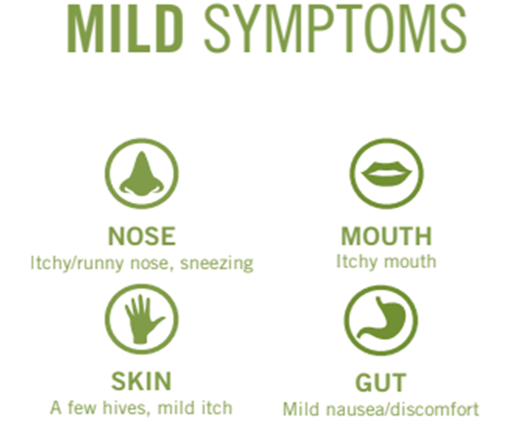
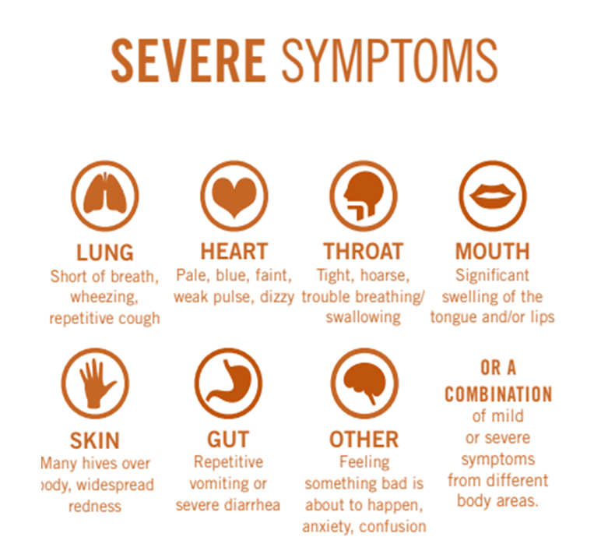
Prevention of and Response to Emergencies Due to Food and Allergic Reaction
Notes:
Talking Points/Facilitation Notes
Introduce this slide by asking participants to raise a hand if they know someone with a food allergy
Explain that food allergies are a growing public health concern so it’s important to understand how to prevent allergic reactions to food when caring for children
Remind providers to talk with the parent to become aware of any known food allergies and work with the family to understand current plans and systems to keep the children safe
(provide examples: gluten allergy – prep food in an area where nothing with gluten touches it)
Share with providers that there are differences between food sensitivities and food allergies, even though they might produce similar symptoms
The symptoms and discomfort produced by food sensitivities are prompted by the digestive system
The symptoms produced by food allergies are prompted by the body’s immune system (can be mild or severe and life threatening)
Review the symptoms on the slide
Share with providers the importance of watching for these symptoms during snacks and meals, especially if they will be introducing new foods to children
Sources
https://www.cdc.gov/healthyschools/foodallergies/index.htm#:~:text=Food%20allergies%20are%20a%20growing,children%20in%20the%20United%20States.&text=That's%201%20in%2013%20children%2C%20or%20about%202%20students%20per%20classroom.
https://www.foodallergy.org/living-food-allergies/food-allergy-essentials/food-allergy-anaphylaxis-emergency-care-plan

Slide 86


Prevention of and Response to Emergencies Due to Food and Allergic Reaction
Learn to investigate food labels
Know the names of allergens
Use color-coded stickers at home
Build an allergy emergency kit
Wash hands with soap and water
Notes:
Talking Points/Facilitation Notes
Introduce this slide by explaining that there are steps providers can take to help prevent allergic reactions
Review the points on the slide:
Learn to investigate food labels and become familiar with the names of allergens
Use color-coded stickers to identify safe (or unsafe) food easily for children who cannot yet read
Build an allergy emergency kit
With medications, epi-pen and a copy of the child’s allergy plan
Consider having two kits, one for at home and one for traveling
If the child does not yet have a plan, consider using the template in the resource packet
Wash hands with soap and water before and after preparing food
Plain water and hand sanitizers are not effective at removing food allergens
Ask providers what questions they might still have about preventing and responding to food allergy reactions
Sources
https://www.cdc.gov/healthyschools/foodallergies/index.htm#:~:text=Food%20allergies%20are%20a%20growing,children%20in%20the%20United%20States.&text=That's%201%20in%2013%20children%2C%20or%20about%202%20students%20per%20classroom.
https://www.foodallergy.org/living-food-allergies/food-allergy-essentials/food-allergy-anaphylaxis-emergency-care-plan
https://www.foodallergy.org/resources/tips-keeping-safe-home
https://www.foodallergy.org/resources/food-allergies-early-childhood

Slide 87
Prevention of and Response to Emergencies Due to Food and Allergic Reaction: Preventing and Responding to Choking
Provider monitors age-appropriate portion size consumption
Provider is aware of age-appropriate solid food for children
Provider supervision should be: (a) Arms reach for children learning to feed themselves (b) Within four feet of children over 12 mo. (c) In position to have children of all ages in sight.
Provider must respond immediately to a choking child using recommended age-appropriate first aid responses as given in training.
Notes:
Talking Points/Facilitation Notes
Introduce the slide and read bullet points out loud to providers.
Explain that a plan to introduce complementary, age-appropriate solid foods to infants should be made in consultation with the child’s parent/guardian and primary health care provider.
The provider should be aware of the plan that has been determined for introducing solid foods.
Children in mid-infancy who are learning to feed themselves should be supervised by an adult seated within arm’s reach of them at all times while they are being fed. Children over twelve months of age who can feed themselves should be supervised by an adult who is seated at the same table or within arm’s reach of the child’s highchair or feeding table. When eating, children should be within sight of an adult at all times.
Portion Size Consumption:
Food for infants should be cut into pieces one-quarter inch or smaller, food for toddlers should be cut into pieces one-half inch or smaller to prevent choking. In addition to the food monitoring, children should always be seated when eating to reduce choking hazards. Children should be supervised while eating, to monitor the size of food and that they are eating appropriately (for example, not stuffing their mouths full).
Reminders for prevention of choking:
“Squirreling” of several pieces of food in the mouth increases the likelihood of choking.
A choking child may not make any noise, so adults must keep their eyes on children who are eating.
Active supervision is imperative.
Supervised eating also promotes the child’s safety by discouraging activities that can lead to choking.
Adults can help children while they are learning, by modeling active chewing.
Ask providers to list choking hazard foods: (name any from list that are missed)
Foods that are round, hard, small, thick and sticky, smooth, compressible or dense, or slippery).
Examples of these foods are:
hot dogs and other meat sticks (whole or sliced into rounds),
raw carrot rounds,
whole grapes,
hard candy,
nuts,
seeds,
raw peas,
hard pretzels,
chips,
peanuts,
popcorn,
rice cakes,
marshmallows,
spoonfuls of peanut butter,
and chunks of meat larger than can be swallowed whole.
Resources
Starting Solid Foods - HealthyChildren.org
Source
CFOC Standards Database | National Resource Center

Slide 88
Precautions in Transporting Children
Notes:
Talking Points/Facilitation Notes
Introduce Precautions in Transporting Children

Slide 89
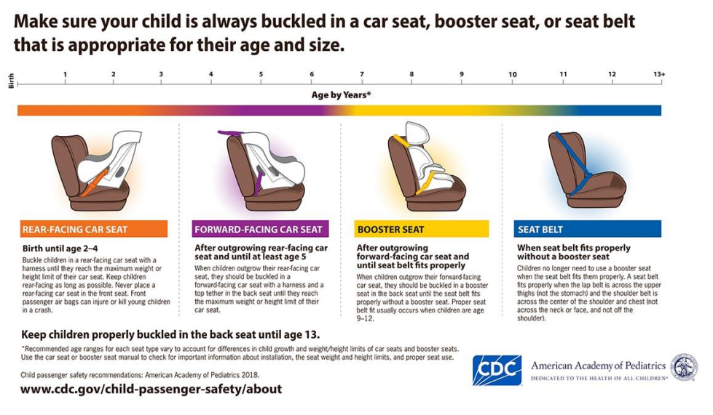
Precautions in Transporting Children
Notes:
Talking Points/Facilitation Notes
Introduce this slide by explaining that transporting children safely is something providers will need to think about if they plan to drive the children anywhere – including occasional rides and emergency situations
Explain that cars are designed to transport adults, which is why we use car seats and booster seats with children: to keep them as safe as possible in a seat that was not designed for someone their size
Reference the graphic on the slide and share that it provides an age guide to identifying the correct type of car seat, although the weight and height of the child will also directly inform what type of seat a child needs, including whether it is rear or forward facing
Share the following information:
There are two types of rear-facing car seats. The Infant Carrier snaps into place into an attached base in the car. These have adjustable handles and are normally only used until an infant is around 1 year old. The other type is the Convertible car seat which can also be used once a child has transitioned into a forward-facing car seat.
The only exception to a child in a rear-facing car seat being placed in the front seat would be if all of the back row seats are occupied. If this happens the air bag must be turned off to prevent serious injury or death.
Children should be kept in a 5-point harness seat until they reach the maximum weight or height for that seat
Remind providers that children must also be able to sit properly and not play with the seatbelt before moving into a booster seat
Share that older children should remain in a booster seat until they are at least 4’9” because this height will help to protect them from being injured by the seat belt during an accident
Share that children should sit in the back seat until at least age 13
Stress the importance of avoiding moving seats from car to car because it increases the risk of the seats not being installed properly
Reference the sticker example in the resource packet and share that it’s a sample information card that you can make to stick to the car seat in case of emergency situations (reference sticker template in resource packet and discuss the information to include)
1. Name(s) of parent, grandparent, aunt, uncle or trusted adult
2. Children allergies/medical conditions
3. Special needs to be aware of
4. Preferred hospital for treatment
Handouts
Emergency Sticker
Source
www.cdc.gov/child-passenger-safety/about

Slide 90
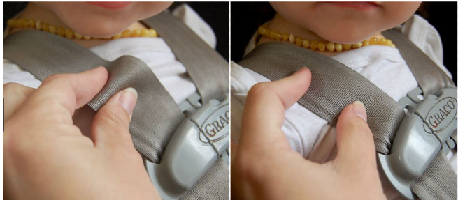
Precautions in Transporting Children: Pinch Test
Too Loose
Just Right
“The two big causes of misuse of car seats are improper harness placement and bulky clothes. The pinch test illustrated here is a way to test that the harness is snug enough. Bulky clothes, such as winter coats, should be removed from the child before they are secured in the car seat”.
Notes:
Talking Points/Facilitation Notes
Introduce this slide by reading the slide to providers
Explain that the next few slides show some common mistakes that people make when using car seats
Share that this slide demonstrates the pinch test, which is used to make sure the straps in the car seat are tight enough
Describe how to perform the pinch test:
Once a child is safely secured in their car seat, make sure the harness is tightly buckled and coming through the correct slots of the seat
With the chest clip placed at armpit level of the child, pinch the strap at the child’s shoulder
If you can pinch the strap, it’s too loose and the harness will need to be tightened again

Slide 91
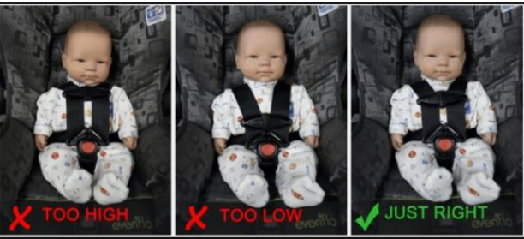
Precautions in Transporting Children: Chest Clip
To find a Certified Child Passenger Safety Technician who can check your seat at no cost, email or call Kara Rueckert RueckertK1@michigan.gov 517-284-3066
Notes:
Talking Points/Facilitation Notes
Introduce this slide by explaining that best practice is to have the car seats installed by a trained tech or checked during a car seat event
Share that providers can use the contact information on this slide to reach someone who can connect them to a trained tech in their area
Explain that this contact person can help them make sure they have the right car seat and help them find a low-cost option if they need a different one
Explain that this slide shows where the chest clip should be placed (it should be at the child’s armpit level)
The position of the harness varies. For a rear-facing car-seat it should be at or below the child’s shoulder. For a forward-facing car-seat it should be at or above the child’s shoulder.

Slide 92
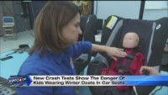
Precautions in Transporting Children: Winter Coats
Notes:
Talking Points/Facilitation Notes
Introduce this slide by explaining that one aspect of car seat safety that’s changed over time involves winter coats
Explain that coats should not be worn underneath the strap of a car seat (includes infants, toddlers, and older children) because the bulk of the coat will make it look like the straps are tight enough to pass the pinch test when they are not
Introduce and show the video (demonstrates this danger using a crash test)
Ask providers what stood out to them from the video
Video Link
https://www.youtube.com/watch?v=yA7r92TFMY8

Slide 93
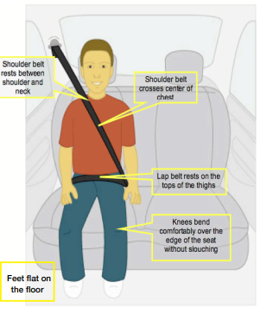
Precautions in Transporting Children: Booster Seats
Children who have outgrown the age, height and weight requirements for a forward-facing car seat that are under 8 y.o, or shorter than 4’9” must use a booster seat.
The safest practice is that children continue to use the booster seat until the seatbelt fits snugly across the thighs and shoulders
Notes:
Talking Points/Facilitation Notes
Introduce this slide by explaining that this image shows how to tell if a child (who should be at least 4’9”) is big enough to sit in a seat without a booster
Explain that booster seats are for children who have outgrown a seat with a harness but do not fit correctly in the seat of the car yet
Share that booster seats must always be used with a shoulder AND a lap belt; they should never be used with a lap belt only
Explain that the shoulder belt should never go behind the child’s back
Share that a common question is “When can children start sitting without a booster seat?”
Reference the graphic on the slide and explain that all of these should be true of a child before they can sit without a booster seat:
The shoulder belt should rest between their shoulder and their neck
The shoulder belt should cross the center of their chest
The lap belt should rest on the tops of their thighs
Their knees should bend comfortably over the end of the seat, without slouching or leaning over
Their feet should rest flat on the floor
Remind providers again that having the car seat installed by a trained tech or checked during an event is highly recommended as is trying to avoid moving seats from car to car
Remind them that they can use the contact information on this slide to reach someone who can connect them to a trained tech in their area

Slide 94
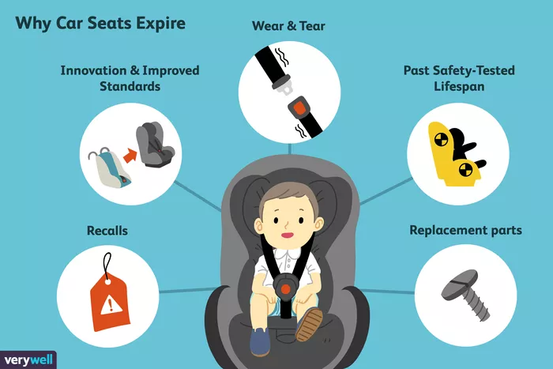
Precautions in Transporting Children: Car Seat Expiration
Notes:
Talking Points/Facilitation Notes
Introduce this slide by explaining that car seats expire
Explain that car seats expire for numerous reasons, including improvements in technology, changing safety standards, wear and tear of the materials from general use, and exposure to extreme heat and cold, Replacement parts.
Car Seats can also become defective if involved in a vehicle crash. Never use a car seat that was involved in an accident. Also, if you are not sure of the history of the car seat use, do not use it.
Stress that car seats can also be recalled and share that the National Highway Traffic Safety Administration provides a list of every car seat recall from the past 10 years on its website (www.nhtsa.gov/recalls)
Sources
https://www.verywellfamily.com/the-facts-about-car-seat-expiration-284382
https://www.nhtsa.gov/recalls

Slide 95

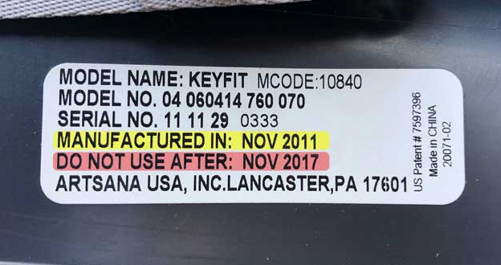
Precautions in Transporting Children: Car Seat Expiration
Notes:
Talking Points/Facilitation Notes
Introduce the final slide in this section by explaining that there is a sticker on the seat that shows the expiration date
Keep in mind that car seats differ in their capacity and their installation directions, so it is important to refer to the manual or the label to ensure accuracy. The label also will identify the manufactured date and the expiration date.
Share that this sticker is often found on the side or back of the seat and reference the examples on the slide
Stress that if providers cannot find the expiration date, they should check the manufacture date and then follow-up with the manufacturer via phone, online, etc.
Review these final points about car seat safety:
Stress to providers that if they ever consider using a used car seat, to be certain of the seat’s history and never use a car seat that has been in an accident
Share that best practice is that if they don’t know the details and whole history of the car seat, don’t buy it
Ask providers what questions they might still have about transporting children
Source
https://www.verywellfamily.com/the-facts-about-car-seat-expiration-284382

Slide 96
Training Opportunities
Notes:
Talking Points/Facilitation Notes
Introduce Training Opportunities

Slide 97

Resource Centers
Notes:
Talking Points/Facilitation Notes
Explain the function of statewide Resource Centers, reminding providers that any questions about their LEP application, billing, or approval will need to be answered by CDC, when resource centers are unable to find the accurate information.
Refer providers to where CDC contact information is posted in the training room and/or let them know that the information will also be on a slide at the end of this section
If training participants virtually, remind them that they can find and/or connect with their local resource by visiting greatstarttoquality.org or calling 1-877-614-7328 and entering their zip code

Slide 98
License Exempt Providers
Level 1
Completion of Level 1 and 10 hours of Level 2 approved core trainings annually
Completion of License Exempt Provider Preservice Training
Level 2
Notes:
Talking Points/Facilitation Notes
Share with providers that they are part of a large effort in Michigan to support people caring for children
Explain that part of this effort includes opportunities for providers to improve the quality of care they provide
Highlight that the LEPPT (today’s training) fulfills the requirement for providers to reach Level 1
Share that, after completing this training, providers have the option to pursue Level 2 and significantly increase the hourly rate they are paid through the parent
Explain that reaching Level 2 requires that providers take an additional 10 hours of training in MiRegistry
Stress that Level 2 trainings must be completed in MiRegistry in order to count
Clarify that maintaining Level 2 requires 10 additional hours within the next 12 months, every year

Slide 99
Training Opportunities:
Training Hours for Level 2 Rate
10 hours of approved training will increase your subsidy rate
Trainings must be a minimum of one hour long
Training must be taken annually to maintain increased subsidy rate
All trainings on the MiRegistry calendar are approved except LEPPT
Notes:
Talking Points/Facilitation Notes
Review the points on the slide:
10 hours of approved training will increase your subsidy rate
Remind providers about the importance of communicating with the parent if they achieve Level 2 status so that it’s clear the increase is meant to be paid to them
Explain that even if they achieve Level 2 in the middle of a period, the hourly rate increase will backdate to the date they achieved it
Explain that the rate increase will be reflected on the next pay period
Trainings must be a minimum of one hour long
Training must be taken annually to maintain increased subsidy rate
Remind providers that, in order to maintain the increased rate/Level 2 status, they must complete 10 hours of approved training each 12-month period from the date they achieve the 10 hours, otherwise their Level 2 status will expire
Each time a provider completes 10 additional hours of training, they will receive a new Level 2 begin and end date
Provide the following to illustrate Level 2
Provider Story: A provider has a Level 2 with a begin date of 2/4/22 and an end date of 2/4/23
In order to maintain their Level 2 rate, the provider will need to complete 10 additional hours of training by 2/4/23
Example 1: Provider completes 6 hours of training on 4/16/22 and 4 hours of training on 2/1/23
Provider completed an additional 10 hours (6+4) of training and will receive a new Level 2 rate begin date of 2/1/23 and an end date of 2/1/24
The Level 2 begin date is the date on which the provider completed the 10th hour of training
Example 2: Provider completed 6 hours of training on 4/16/22 and 4 hours of training on 8/10/22
Provider completed an additional 10 hours (6+4) of training and will receive a new Level 2 rate begin date of 8/10/22
Again, each time a provider completes an additional 10 hours of training, they receive a new Level 2 begin and end date
All trainings on the MiRegistry calendar are approved except for the LEPPT
Remind providers to wait until at least the day after they complete the LEPPT to begin more training hours to ensure their Level 1 status is reflected first

Slide 100

MiRegistry
Search and register for training to meet Level 2 training hours.
        www.miregistry.org
        support@miregistry.org
        833-386-9238
        888-825-9995
Notes:
Talking Points/Facilitation Notes
Explain the functions of MiRegistry based on the interests/needs of the providers in your session
Show providers MiRegistry resources and talk through FAQs and tips
How to search for trainings
How to register for trainings
How to access online training (would recommend using the required Ongoing Health & Safety Refresher course)
Don’t use too many search filters
Encourage providers to follow along on their phone and sign up for trainings themselves
Remind providers in your region where they can see upcoming trainings (follow on Facebook)
Remind providers that they will need to take the Ongoing Health & Safety Refresher course each year
Source
https://www.miregistry.org/

Slide 101
Child Development and Care Program Information
www.Michigan.gov/childcare
866-990-3227
517-284-7529
Notes:
Talking Points/Facilitation Notes
Encourage providers to enter this contact information into their phones if they haven’t already taken the opportunity to do so

Slide 102
Pediatric First Aid and
Pediatric Cardiopulmonary Resuscitation (CPR)
Notes:
Talking Points/Facilitation Notes
Introduce Pediatric First Aid and CPR
This section is to be completed by the Resource Center’s approved First Aid/CPR entity

Slide 103

CPR and First Aid Basics
Notes:
Talking Points/Facilitation Notes
This content will not certify you in CPR/First Aid, but it does meet the requirement to become a License-Exempt Provider
We highly recommend you join one of our in-person offerings if you’re able to do so in the future
Providers trained in CPR and First Aid can lessen the consequences of injury and reduce the potential of life-threatening conditions for the children we care for, and those we work with. The next section of this training will discuss Cardiopulmonary Resuscitation (CPR) and First Aid

Slide 104




What is First Aid?
Used when emergent treatment is needed for an injury or illness.
The injury or illness may or may not require additional medical treatment
Notes:
Talking Points/Facilitation Notes
Let’s look at what First Aid is
First Aid is used when emergent treatment is needed for an injury or illness
The injury or illness may or may not require additional medical treatment
First Aid is important because when an injury occurs, there may be only moments to provide the type of care that could save a life

Slide 105
First Aid Topics
Hemorrhage
Bleeding Open Wound
Seizures
Allergic Reactions
Burns
Poisoning
Shock
Head Injury
Notes:
Talking Points/Facilitation Notes
There are many First Aid topics. Let’s talk about those listed here
For a hemorrhage, which involves serious bleeding, remove any clothing or debris from the wound and put your effort into stopping the bleeding. Apply a tourniquet to the affected limb, or a pressure dressing if not a limb. Have the person lie down. Immobilize the affected area and call 911
For a minor open wound that is bleeding, cleanse and apply pressure
The first action with seizures is to place the child on the floor and turn them on their side. If this is a child with a history of seizures, there should be a care plan discussing medications and treatments. Always notify the parents of a seizure. If the seizure does not resolve quickly call 911
For allergic reactions, observe the child for an anaphylactic reaction. If noted, inject epinephrine immediately and call 911. If the individual stops breathing, do CPR. This is covered in more detail in the food allergy section
Burns can be different levels of severity. 1st degree is red without blisters, 2nd degree involves blisters and is very painful, & with 3rd degree the area is very stiff. Never apply butter or ointment to a burn. For 1st & 2nd degree burns run them under cool water. For 3rd degree just apply a clean, dry, dressing. for anything other than a very minor burn 911 should be called.
For poisoning, do not induce vomiting. Call the Poison Control Hotline and follow their directions
If you see a child with pale clammy skin after a trauma, they may be in shock. Lay them down, elevate their legs, cover them with a blanket, and call 911
If a head injury involves bleeding, follow the treatment for a bleeding open wound. Additional treatment for a head injury is dependent on how serious it is. If minor, apply ice wrapped in a towel for 20 minutes to reduce swelling and pain. Repeat in one hour. Observe for signs of a possible more serious injury, such as like loss of consciousness, changes in behavior, blood or fluid from nose or ear, seizures. If any of these occur call 911
For a full description of how to react in any of these circumstances it is important to be First Aid certified and follow the training provided

Slide 106
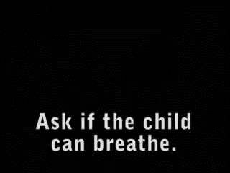

Choking
Notes:
Talking Points/Facilitation Notes
Young children frequently put things in their mouths, increasing the risk of choking. Therefore, we will review choking
It is important that you know how to respond to a child in distress
Our first video addressed a child who may be choking
When you suspect that a child is choking, first ask if they can breathe
Then do abdominal thrusts by placing your fist in the upper waist and forcefully thrusting upward
Continue this until the child begins breathing. If the child collapses, call 911 and begin CPR
There are two items we would like to bring to your attention here.
1) The technique you are reviewing for children is the same one you would use with adults.
2) American Red Cross and the American Heart Association(AHA) have different approaches for treating choking for children & adults. The American Red Cross teaches the combination of abdominal thrusts and back blows. The AHA association teaches to only give abdominal thrusts. Both are acceptable practices.
The second video demonstrated what should be done when you suspect an infant is choking
With a choking infant you first check if the infant is breathing. As you saw in the video, the child is lying on the rescuer’s forearm. First administer 5 back slaps
Then turn the infant onto the opposite forearm and administer five chest thrusts
If the infant is still not breathing repeat the cycle over and over until the infant begins breathing. If the infant becomes non-responsive call 911 and begin CPR

Slide 107
Cardiopulmonary Resuscitation
Life-saving procedure used when an infant, child, or adult’s heart stops beating, or they are unable to breathe
Includes management of blocked airway, rescue breathing, and chest compressions
Notes:
Talking Points/Facilitation Notes
Cardiopulmonary Resuscitation is frequently referred to as CPR
CPR is a life-saving procedure used when an infant, child or adult’s heart stops beating, or they are unable to breathe
CPR includes management of blocked airways, rescue breathing and chest compressions

Slide 108

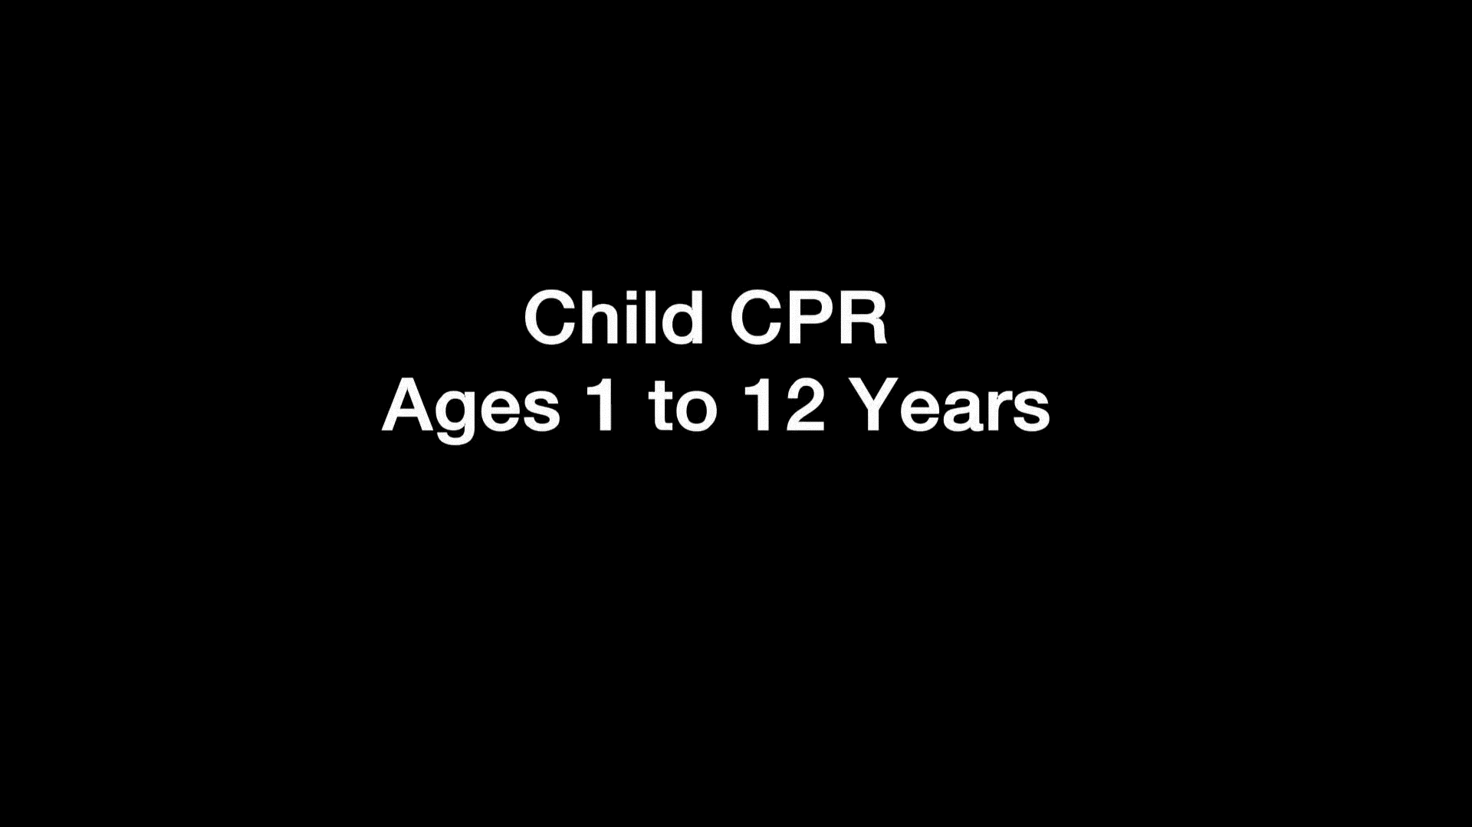
Chest Compressions
Notes:
Talking Points/Facilitation Notes
Now we are going to cover chest compressions and rescue breaths
When conducting CPR on an adult, use 2 hands and press down 2 to 2 ½ inches. Place the heel of one hand in the center of the chest on the breastbone. Place the heel of the other hand directly on top of the first. Interlace the fingers. Position your shoulders directly over your hands. Keep your arms straight & push down
When applying CPR to a child, use 1 or 2 hands depending on the size of the child, and press down 2 inches
For an infant, use 2 fingers and press down 1&½ inches
The rate should be 100 chest compressions per minute. As you are working with someone, a strategy to keep focused is to sing the song "Staying Alive." This can help you time your compressions to be 100 per minute
Note: When you are doing compressions, the rate and amount do not change. However, the strength of the compression varies with infants, children, and adults
Cincinnatichildrens.org/health/c/infant-cpr Video link for Infant CPR
Cincinnatichildrens.org/health/c/child-cpr Video link for Child CPR
When you click the slides, the table will disappear and the videos will appear. To watch video, click each one
Now let’s see what it looks like in action for infants and children

Slide 109







CPR Steps
Check the area is safe, lay victim flat
Call 911 or ask someone else to
Check for breathing, if not breathing start CPR
Perform 30 chest compressions
Open airway/tilt chin back
Perform two rescue breaths
Repeat until ambulance or automated external defibrillator (AED) arrives
Notes:
Talking Points/Facilitation Notes
Check that the area is safe and lay the victim flat. If the area appears safe, approach the victim from the side. Tap their shoulder and shout “Hey, are you okay?” If the victim is unresponsive this is an emergency
If someone else is there send them to call 911. If an AED is close send them to get the AED. If the victim is an adult and you are alone, you may have to get a phone and the AED before starting CPR on an adult. It is important to stress that If the victim is a child or infant and you are alone, you need to perform CPR for 2 minutes before leaving to call 911
Check breathing. If they are not breathing, start CPR. Look at the victim’s chest for 5-10 seconds to evaluate for breathing before starting CPR. Remember to Look-Listen-and Feel. Look for the chest rising. Listen for air exchange. Feel for air moving
Perform 30 chest compressions
Open the airway and tilt the chin back. To open the airway place one hand on the forehead and apply firm, backward pressure. Place the fingers of your other hand on the bony part of the jaw and lift the chin
Provide two rescue breaths. For mouth-to-mouth breaths, open the airway and pinch the nose. Inhale a regular-sized breath, seal your mouth over the victim’s mouth and give two breaths for 1 second each
Repeat until ambulance or someone with an AED arrives. Repeat this cycle and continue CPR until help arrives or you become too exhausted to continue
Use CPR when an adult is not breathing or when they are only gasping occasionally, and when they are not responding to questions or taps on the shoulder. In children and infants, use CPR when they are not breathing normally and not responding

Slide 110
Test Your Knowledge Scenarios
Activity
Baby Anna chokes while eating her lunch
Devonte falls off the climbing gym at the playground and has a bleeding cut on his knee
You walk into the kitchen to find your co-worker, Emi, lying on the floor non-responsive
Notes:
Talking Points/Facilitation Notes
If any participants select the wrong answer, explain the correct procedure in detail again before moving on to the next item.
We will be having our last poll of the day. There are three scenarios, please select the best answer for each scenario.
Virtual Activity
Set up each poll with multiple choice answers
The answers below are the correct answers that should be included in the multiple-choice options
Baby Anna - Lay her over your forearm, do 5 back slaps between the shoulder blades, then turn her over onto your other arm, do 5 chest compressions just under the nipple line. Repeat this cycle until she starts breathing or crying. If she becomes non-responsive call 911 and begin CPR
Devonte - Clean the wound and apply pressure with a clean gauze or dressing
Emi - Check the scene for safety, call for help, begin CPR

Slide 111

Please complete the POST-Survey so you can receive credit for this training!
https://forms.office.com/r/DDfynJsr5B
Notes:
Talking Points/Facilitation Notes
Guide participants to complete the post-survey and provide support as needed
Remind providers they must complete this survey to receive credit for the course
https://forms.office.com/r/DDfynJsr5B
*make sure participants type this link directly into their browser; if they do a search it will bring up the entire LEPPT PowerPoint pdf*
If training virtually, type the link into the chat box

Slide 112


